Slide 1
Working with Self-Wicking Grids
Version 1.11

Slide 2
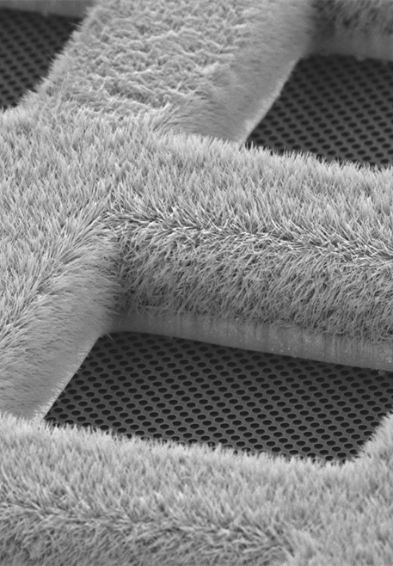
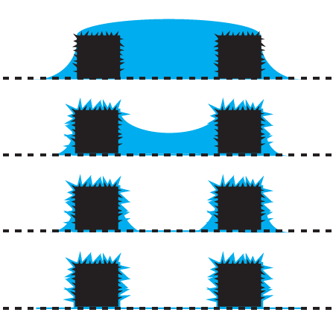
Self-wicking grids produce thin ice without blotting
Bars coated with copper hydroxide nanowires
Removes the need for physically blotting away sample using filter paper
Can produce a thin film quickly, which can be beneficial for tackling air-water-interface denaturation/dissociation and preferential orientation problems
Glow discharge can be used to control the wicking process

Slide 3
Grid preparation protocols
Sample + nanowire grid wicking behaviour is unknown at the start
First interaction requires wicking characterization to prepare grids with appropriate ice thickness
Use Two-stripe dispense mode to characterize wicking
When you know how your sample wicks on the grid, then use knowledge gained from characterization to move to One-stripe dispense mode

Slide 4
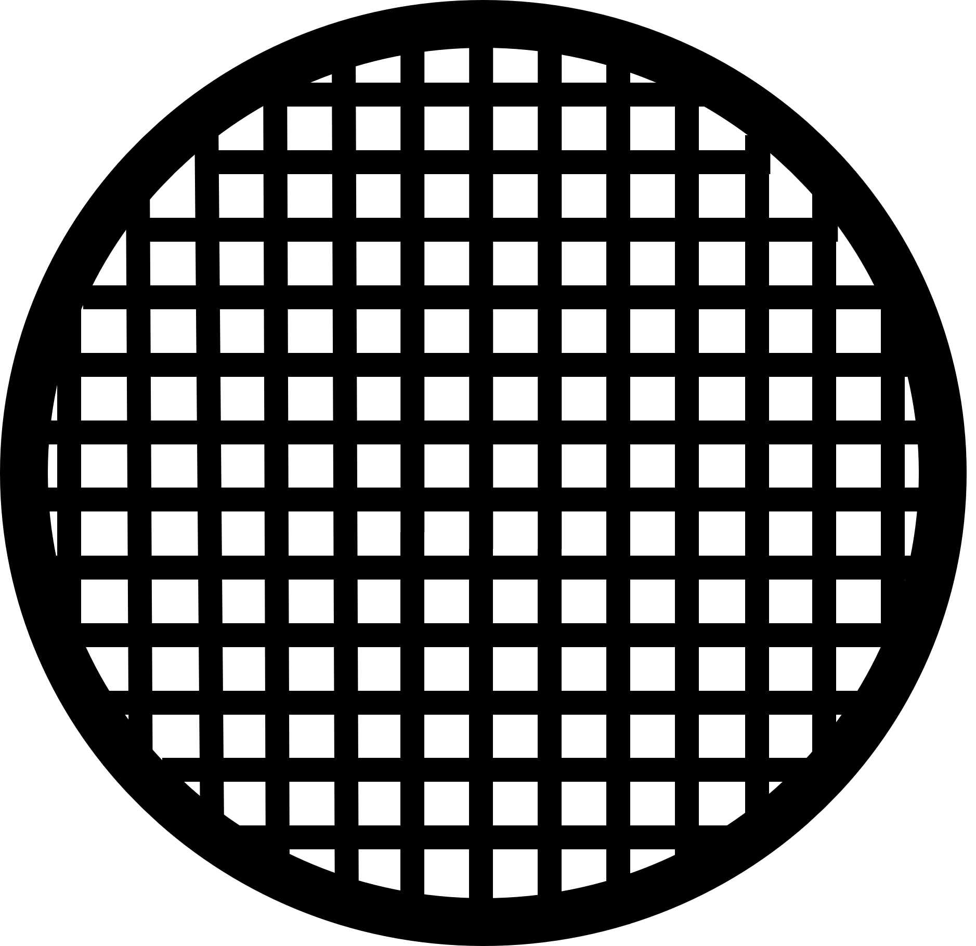
Grid preparation protocols
Wicking characterization stripe
Two-stripe (2-S) Dispense Mode
Wicking characterization stripe: To determine the appropriate wicking time for a particular grid and sample
Plunge stripe: To freeze the grid based on the wicking time determined using the wicking stripe
One-stripe (1-S) Dispense Mode
Plunge stripe only: To freeze the grid based on the parameters determined using the two-stripe dispense mode
Plunge stripe

Slide 5
Two-stripe Dispense Mode

Slide 6
Step 1: Wicking Characterization (1st stripe)
2-S Mode
Sample is sprayed on to the grid as it moves past the dispenser
Grid continues downward and arrives in front of the camera
A 2500ms video of the grid is captured in order to observe the wicking process
The grid is kept at room temp during characterization
Wicking characterization stripe

Slide 7
Step 1: Wicking Characterization (1st stripe)
2-S Mode
An automated algorithm analyses the video and suggests a wicking time
44ms
100ms
300ms

Slide 8
Step 1: Wicking Characterization (1st stripe)
2-S Mode
In this example, the algorithm identifies 100ms as the wicking time
44ms
100ms
300ms

Slide 9
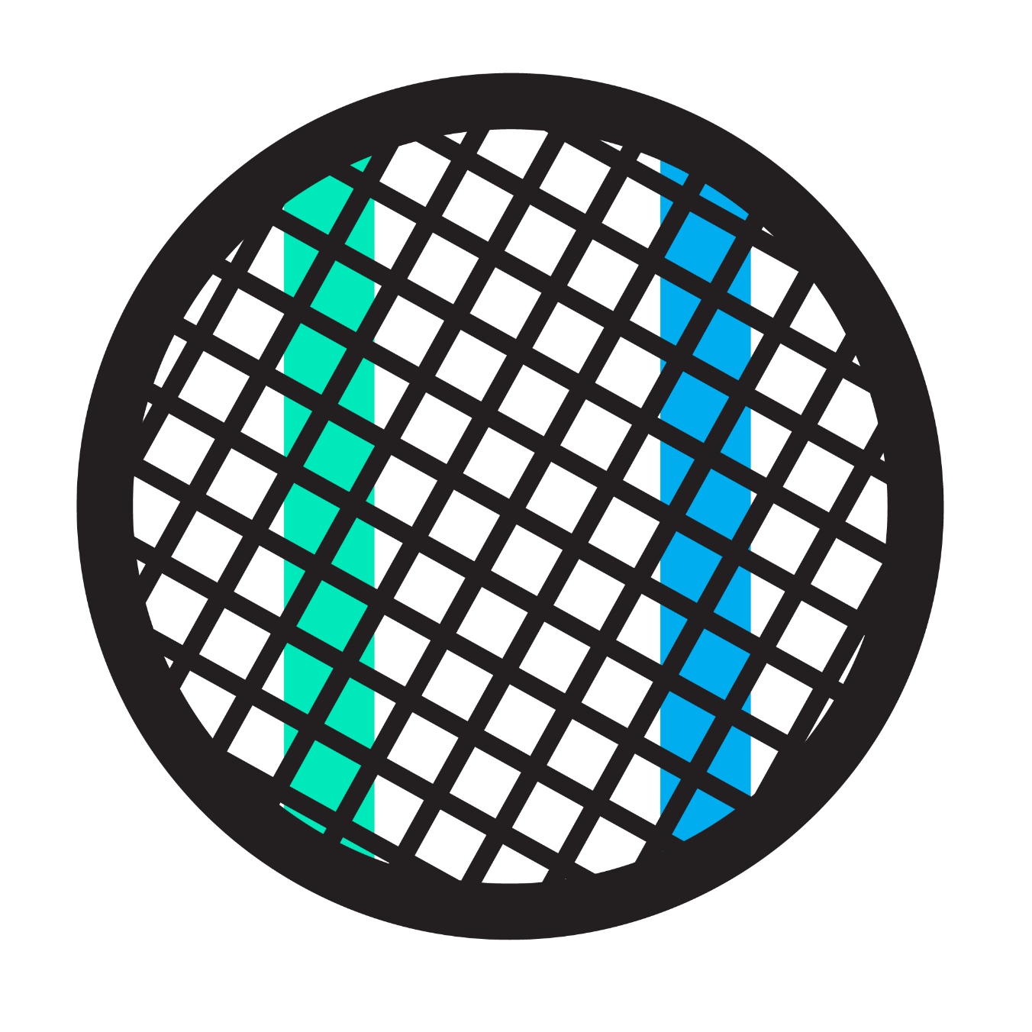
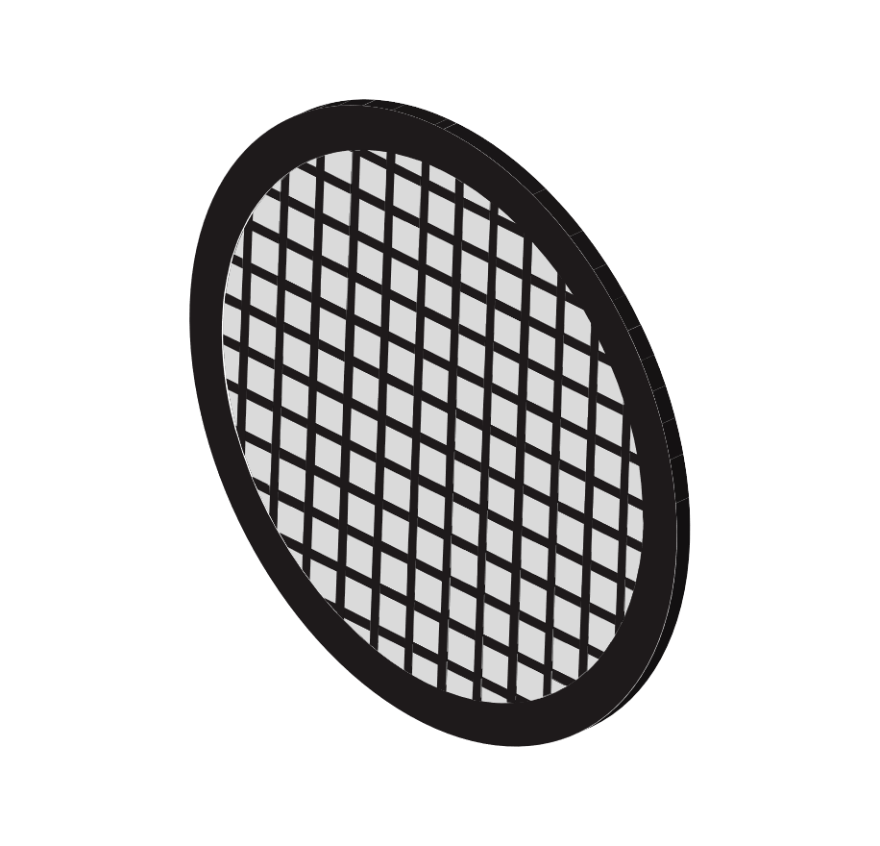
Step 2: Plunge - Determine Plunge Offset for 2nd stripe
2-S Mode
2-S Mode
Wicking is usually slower when the grid is sprayed a second time
Going from characterization to plunge stripe, need to determine a “plunge offset”
Plunge Time = Wicking Time x Plunge offset
plunge stripe
wicking characterization stripe
When the characterization stripe wicks quickly, use ~2x plunge offset as a starting point
Ex. 100ms x 2 = 200ms
When the characterization stripe wicks more slowly, use a larger offset
Ex. 500ms x 3 = 1500ms
Algorithm automatically suggests offset based on the wicking time from the characterization stripe
Plunge offset is not a well-defined variable, and will be different from one sample to another
100ms
wicking time identified by algorithm

Slide 10
Step 2: Plunge – 200ms dispense-to-plunge
2-S Mode
It takes 44ms for the grid to travel from the dispense location into view of the camera
The grid stays in front of the video camera until ~50ms before the selected plunge time
The video is used to decide to accept or reject the grid

Slide 11
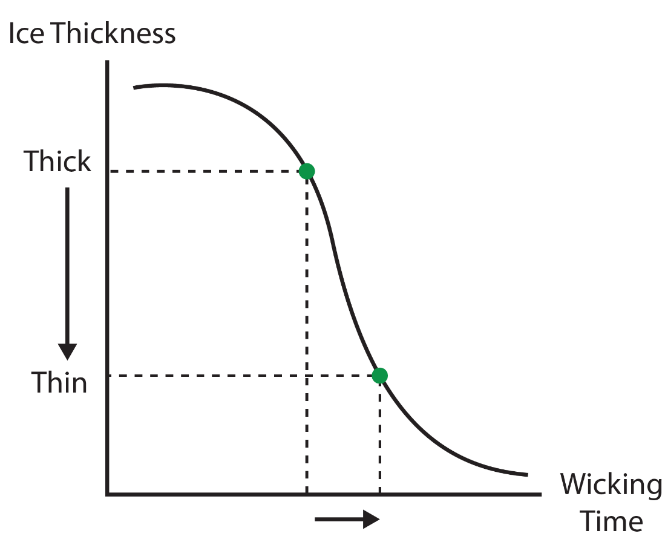
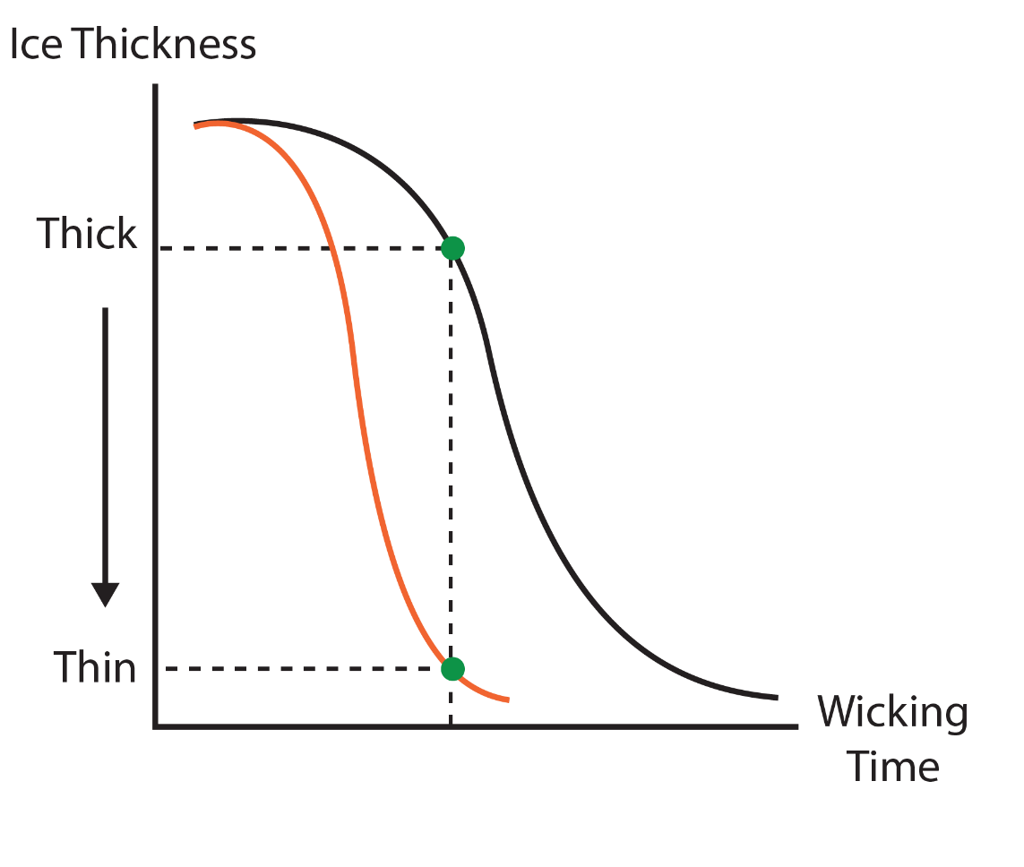
Getting the appropriate ice thickness
2 variables to adjust:
Plunge offset
Increasing the plunge offset allows wicking to happen for longer time
More sample is wicked away with longer wicking time, resulting in grids with thinner ice
Larger plunge offset/longer wicking time results in “slower” grids
Glow discharge
Increasing glow discharge increases the wicking speed
Same degree of wicking occurs in less time with more glow discharge
increased glow discharge

Slide 12
Getting the appropriate ice thickness
Ice thickness is inversely proportional to the degree of wicking
Degree of wicking is proportional to the wicking time
Ice thickness
Wicking time
Degree of Wicking
Degree of Wicking
If the final frame of the wicking video before plunging appears as below, then how would we evaluate it?
Underwicked
Reject
Underwicked
Reject
Underwicked
Acceptable
Good
Very Good
Overwicked
Acceptable
Time

Slide 13
Case Study: achieving appropriately wicked grids
2-S Mode
Grid | Glow Discharge | Wicking Characterization | Plunge Offset | Plunge | Evaluation
1 | 12mA 40s | 300ms | 2x | 600ms | Underwicked
2 | 12mA 40s | 400ms | 2x | 800ms | Underwicked
2 grids have been frozen using the two-stripe dispense mode
Both are evaluated to be underwicked when a 2x plunge offset is applied
What should you do to get appropriately wicked grids?

Slide 14
Case Study: achieving appropriately wicked grids
Option 1: Increase plunge offset
2-S Mode
Grid | Glow Discharge | Wicking Characterization | Plunge Offset | Plunge | Evaluation
1 | 12mA 40s | 300ms | 2x | 600ms | Underwicked
2 | 12mA 40s | 400ms | 2x | 800ms | Underwicked
3 | 12mA 40s | 450ms | 3x | 1350ms | Good
4 | 12mA 40s | 350ms | 3x | 1050ms | Good
More time for wicking, resulting in grids with thinner ice
Dispense-to-plunge time is longer
may not be desirable for tackling sample denaturation/preferential orientation
Slower wicking grids (>300ms) generally require larger plunge offsets

Slide 15
Case Study: achieving appropriately wicked grids
Option 2: Increase glow discharge
2-S Mode
Grid | Glow Discharge | Wicking Characterization | Plunge Offset | Plunge | Evaluation
1 | 12mA 40s | 300ms | 2x | 600ms | Underwicked
2 | 12mA 40s | 400ms | 2x | 800ms | Underwicked
3 | 12mA 80s | 100ms | 2x | 200ms | Good
4 | 12mA 80s | 80ms | 2x | 160ms | Good
Wicking speed increases
Dispense-to-plunge time decreases
may be better for resolving AWI interface issues

Slide 16
Grid preparation protocols
2-S Mode
Two-stripe (2-S) Dispense Mode
Wicking characterization stripe: To determine the appropriate wicking time and glow discharge parameters for a particular grid and sample
Plunge stripe: To freeze the grid based on the wicking time and glow discharge determined using the wicking stripe
One-stripe (1-S) Dispense Mode
Plunge stripe only: To freeze the grid based on the parameters determined using the two-stripe dispense mode
Wicking characterization stripe
Plunge stripe

Slide 17
One-stripe Dispense Mode

Slide 18
Grid preparation protocols
1-S Mode
Two-stripe (2-S) Dispense Mode
Wicking characterization stripe: To determine the appropriate wicking time and glow discharge parameters for a particular grid and sample
Plunge stripe: To freeze the grid based on the wicking time and glow discharge determined using the wicking stripe
One-stripe (1-S) Dispense Mode
Plunge stripe only: To freeze the grid based on the parameters determined using the two-stripe dispense mode
Plunge stripe

Slide 19
One-stripe Dispense Mode
1-S Mode
No wicking characterization is performed. The grid is plunge frozen the first time the sample is dispensed onto the grid
A video of the wicking process is recorded by the camera on its way to the ethane cup
Accept or reject the grid based on the degree of wicking observed

Slide 20
One-stripe Dispense Mode
1-S Mode
Dispense-to-plunge time can be nominated by user (54ms or 101ms – 2500ms)
Why use one-stripe dispense mode?
Removes the need for a plunge offset
Sample is sprayed onto the only grid once, achieving faster dispense-to-plunge time relative to two-stripe dispense mode

Slide 21
Case Study
Grid | Glow Discharge | Wicking Characterization | Plunge Offset | Plunge | Evaluation
1 | 12mA 40s | – | – | 101ms | Underwicked
2 | 12mA 40s | – | – | 101ms | Underwicked
Two grids were plunged at 101ms, but both are underwicked.
How can I get appropriately wicked grids using one-stripe dispense mode?

Slide 22
Case Study
Grid | Glow Discharge | Wicking Characterization | Plunge Offset | Plunge | Evaluation
1 | 12mA 40s | – | – | 101ms | Underwicked
2 | 12mA 40s | – | – | 101ms | Underwicked
3 | 12mA 80s | – | – | 101ms | Overwicked
Option 1:
Keep dispense-to-plunge time constant and increase glow discharge
Wicking speed increases

Slide 23
Case Study
Grid | Glow Discharge | Wicking Characterization | Plunge Offset | Plunge | Evaluation
1 | 12mA 40s | – | – | 101ms | Underwicked
2 | 12mA 40s | – | – | 101ms | Underwicked
3 | 12mA 80s | – | – | 101ms | Overwicked
4 | 12mA 60s | – | – | 101ms | Good
Consider the information we have now gained:
Grid is wicking too slowly with 40s glow discharge (Grid #1, 2)
Grid is wicking too quickly with 80s glow discharge (Grid #3)
Reduce glow discharge time to 60s on the next grid (Grid #4)

Slide 24
Case Study
Grid | Glow Discharge | Wicking Characterization | Plunge Offset | Plunge | Evaluation
1 | 12mA 40s | – | – | 101ms | Underwicked
2 | 12mA 40s | – | – | 101ms | Underwicked
3 | 12mA 80s | – | – | 101ms | Overwicked
4 | 12mA 60s | – | – | 101ms | Good
5 | 12mA 80s | – | – | 54ms | Good
Option 2:
Change the dispense-to-plunge time and hold glow discharge constant
80s of glow discharge and 101ms dispense-to-plunge time resulted in an overwicked grid (#3)

Slide 25
Freezing Strategy

Slide 26
Two-stripe vs One-stripe Dispense Mode
 | Two-stripe | One-stripe
Advantages | Determine glow discharge required for the desired wicking speed while potentially getting useful grids | Faster dispense-to-plunge times Does not require a plunge offset
Disadvantages | Slower dispense-to-plunge times Variable offsets | Prior knowledge on glow discharge amount required

Slide 27
Freezing Strategy
Use a mix of two-stripe and one-stripe dispense modes to optimize the glow discharge on-the-fly to get fast dispense-to-plunge times with appropriate ice thickness.
Use two-stripe dispense mode first
Adjust glow discharge to achieve appropriate wicking times for the sample during wicking characterization step.
Use offsets to still produce usable, but potentially slower grids
Switch to one-stripe dispense mode
When the wicking characterization time is consistently in the target range switch to the one-stripe protocol to plunge in the target range
Further increase glow discharge to go faster, e.g. from 101ms to 54ms

Slide 28
Case Study
Grid | Glow Discharge | Wicking Characterization | Plunge Offset | Plunge | Evaluation
1 | 12mA 40s | 300ms | 2x | 600ms | Underwicked
2 | 12mA 40s | 400ms | 2x | 800ms | Underwicked
3 | 12mA 80s | 100ms | 2x | 200ms | Good
4 | 12mA 80s | 80ms | 2x | 160ms | Good
How to do faster plunges to see if there is improvement in denaturation caused by the air-water-interface?
When is the right time to switch to one-stripe protocol?

Slide 29
Case Study
Grid | Glow Discharge | Wicking Characterization | Plunge Offset | Plunge | Evaluation
1 | 12mA 40s | 300ms | 2x | 600ms | Underwicked
2 | 12mA 40s | 400ms | 2x | 800ms | Underwicked
3 | 12mA 80s | 100ms | 2x | 200ms | Good
4 | 12mA 80s | 80ms | 2x | 160ms | Good
5 | 12mA 80s | – | – | 101ms | Good
Grid #3 and #4 with glow discharge of 12mA 80s both give wicking characterization times of 80-100ms
Switch to one-stripe dispense mode on Grid #5 to plunge at 101ms, while keeping the same glow discharge settings

Slide 30
Case Study
Grid | Glow Discharge | Wicking Characterization | Plunge Offset | Plunge | Evaluation
1 | 12mA 40s | 300ms | 2x | 600ms | Underwicked
2 | 12mA 40s | 400ms | 2x | 800ms | Underwicked
3 | 12mA 80s | 100ms | 2x | 200ms | Good
4 | 12mA 80s | 80ms | 2x | 160ms | Good
5 | 12mA 80s | – | – | 101ms | Good
How to achieve the fastest dispense-to-plunge time possible (54ms)?

Slide 31
Case Study
Grid | Glow Discharge | Wicking Characterization | Plunge Offset | Plunge | Evaluation
1 | 12mA 40s | 300ms | 2x | 600ms | Underwicked
2 | 12mA 40s | 400ms | 2x | 800ms | Underwicked
3 | 12mA 80s | 100ms | 2x | 200ms | Good
4 | 12mA 80s | 80ms | 2x | 160ms | Good
5 | 12mA 80s | – | – | 101ms | Good
6 | 12mA 100s | – | – | 54ms | Good
To plunge using 54ms one-stripe dispense mode, the grid needs to wick even faster than 101ms.
Further increase glow discharge (i.e. from 80s to 100s) to speed up wicking

Slide 32
Key Points Summary
Wicking can be assessed using videos and an automated algorithm
Film thickness (and resulting ice) can be controlled:
Increasing glow discharge speeds up wicking, requiring less wicking time to achieve thin films
Increasing plunge time gives more time for wicking, resulting in grids with thinner films
Use two-stripe dispense mode to determine the glow discharge required to achieve desired wicking speed while still producing grids
Use one-stripe dispense mode to achieve grids with short dispense-to-plunge times
Combine both two-stripe and one-stripe in the same freezing session to optimize the glow discharge needed to get appropriate ice thickness at short dispense-to-plunge time

Slide 33
Quiz
Which of the following parameters can be adjusted to change the ice thickness achieved using self-wicking grids?
Glow discharge
Ethane temperature
Plunge offset
Dispense amplitude
When should I switch from two-stripe to one-stripe dispense mode?
when grids are consistently underwicked
when grids are consistently overwicked
when grids are glow discharged for longer than 100s
when consistently wicking time in the target range is achieved during wicking characterization
What are the benefits of one-stripe dispense mode?
Can determine amount of glow discharge required for the desired wicking speed while potentially getting useful grids
Does not require prior knowledge of glow discharge amount required to achieve the desired wicking speed
Can freeze grids at short dispense-to-plunge time
Does not require the use of offsets
What is the expected effect of increasing glow discharge applied?
Increases wicking speed, grids have thinner ice
Decreases wicking speed, grids have thicker ice
Increases wicking time, grids have thinner ice
Decreases wicking time, grids have thicker ice

Slide 34
Quiz
Which of the following parameters can be adjusted to change the ice thickness achieved using self-wicking grids?
Glow discharge
Ethane temperature
Plunge offset
Dispense amplitude
When should I switch from two-stripe to one-stripe dispense mode?
when grids are consistently underwicked
when grids are consistently overwicked
when grids are glow discharged for longer than 100s
when consistently wicking time in the target range is achieved during wicking characterization
What are the benefits of one-stripe dispense mode?
Can determine amount of glow discharge required for the desired wicking speed while potentially getting useful grids
Does not require prior knowledge of glow discharge amount required to achieve the desired wicking speed
Can freeze grids at short dispense-to-plunge time
Does not require the use of offsets
What is the expected effect of increasing glow discharge applied?
Increases wicking speed, grids have thinner ice
Decreases wicking speed, grids have thicker ice
Increases wicking time, grids have thinner ice
Decreases wicking time, grids have thicker ice

