Slide 1
Chameleon Workflows
Version 1.11

Slide 2
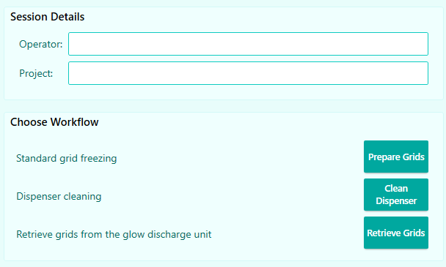
Three Workflows
Prepare Grids
Freeze grids with protein samples
Clean Dispenser
Perform extra cleaning to restore dispenser performance
Additional cleaning options available
Retrieve Grids
Retrieve any grids dropped in the glow discharge unit
chameleon workflows

Slide 3
Workflow Overview
Select Mode
Retrieve Grids
Prepare Grids
Clean Dispenser
Helium Sparge / Dispenser Setup / Test
Clean / Dry
chameleon workflows
Load Cryogens / Button / Grids
Aspirate Sample / Test Dispenser
Glow / Characterize / Plunge
Clean / Dry

Slide 4
Prepare Grids Workflow

Slide 5
Freeze grids with protein samples
Helium Sparge
Load Cryogens
Place Grid Button
Load Grids
Glow Discharge
Load Sample
Plunge
Accept / Reject
Next Grid
Test Dispenser
(with water)
Setup Dispenser
Dry Dispenser
Finished
Test Dispenser
(with sample)
Test Dispenser
(with water)
Remove Cryogens
Wicking Characterization
Clean Dispenser
Prepare grids workflow
Additional Glow Discharge
Setup
Prepare grids
Clean-up
optional step

Slide 6
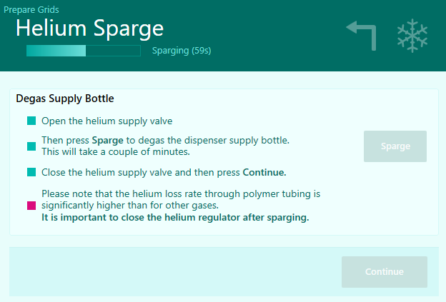
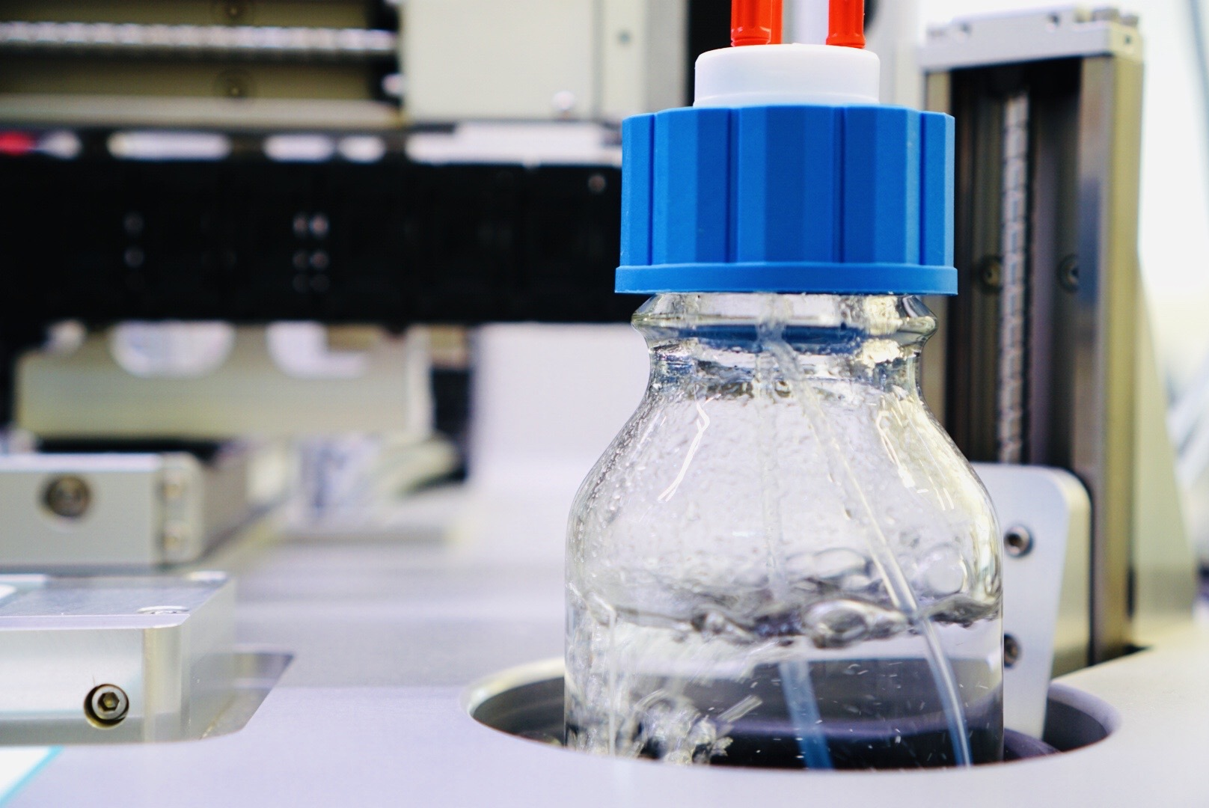
Helium Sparge
Degassed dispenser fluid is required
Helium gas is pumped into the dispenser fluid to remove dissolved gases
Prepare grids workflow

Slide 7
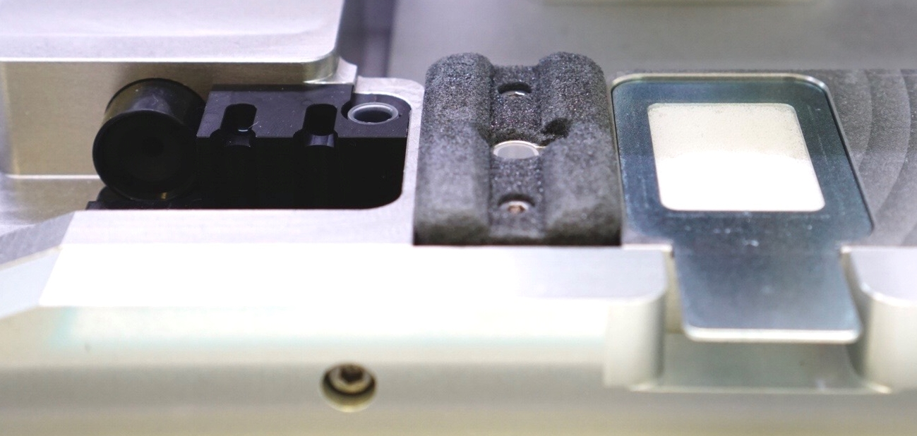
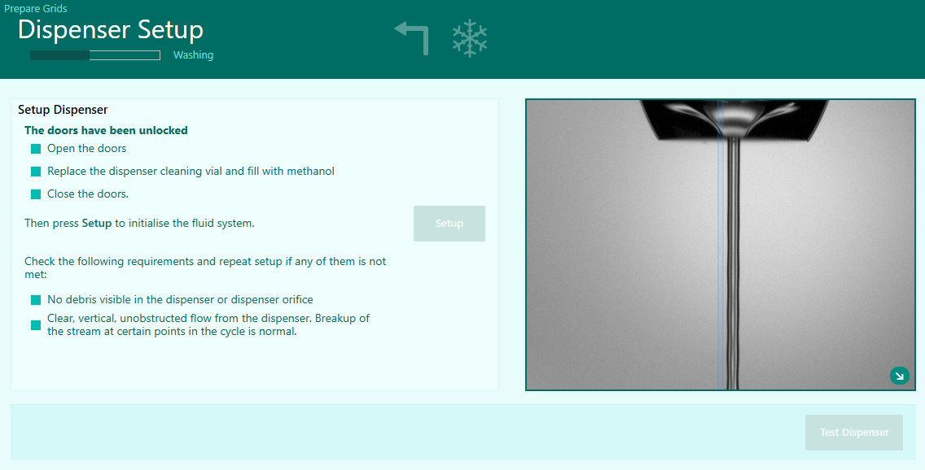
Setup dispenser
Fill cleaning vial with methanol
System uses methanol and HPLC water to setup the dispenser
User should confirm vertical, unobstructed flow
Cleaning Vial
Prepare grids workflow

Slide 8
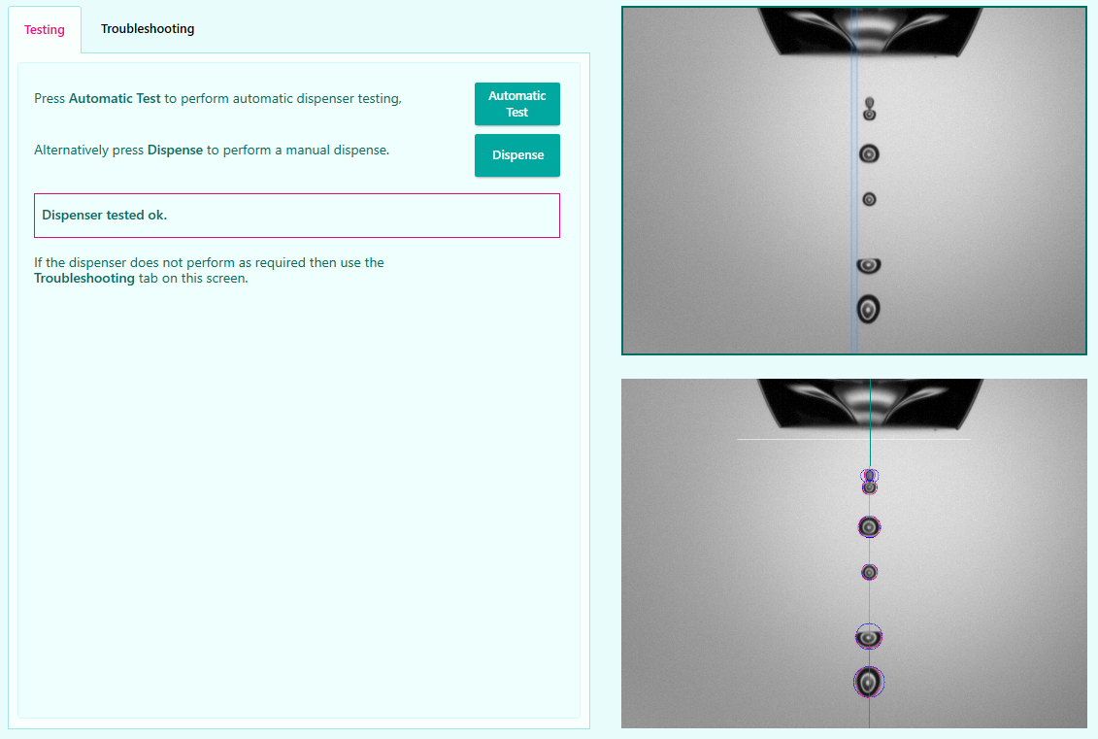
Test dispenser
Water is used to ensure dispenser is performing well
Dispensing pattern should be vertical and consistent between each test dispense
Dispenser issues identified when dispensing water will be magnified when dispensing samples

Slide 9
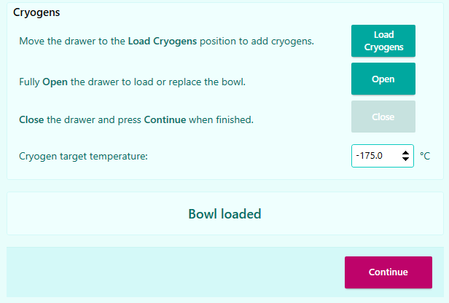
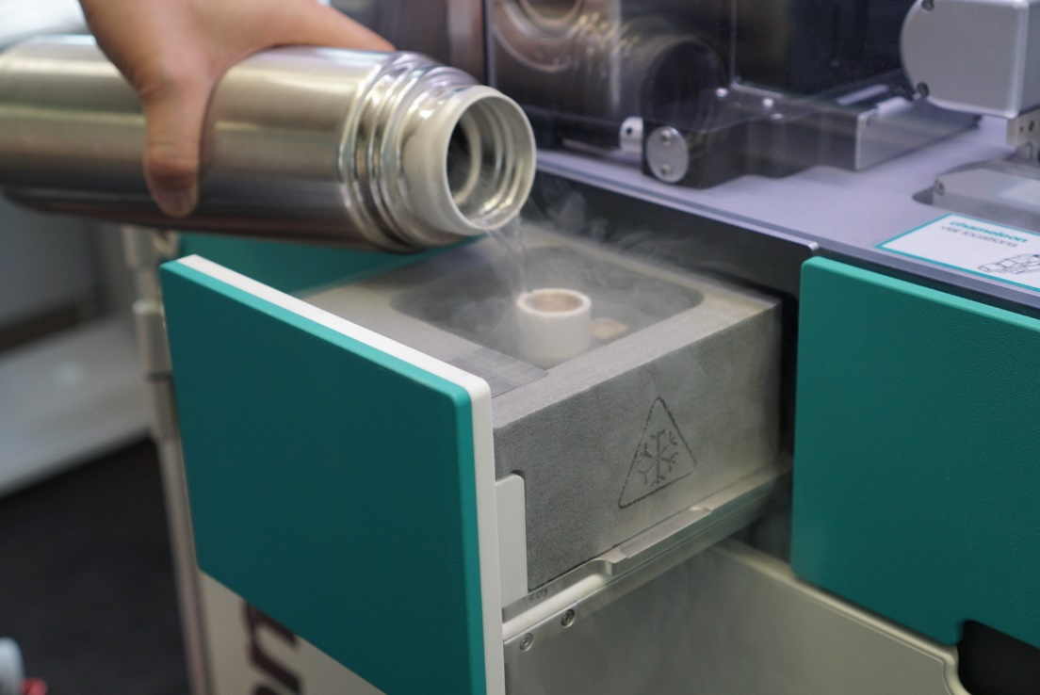
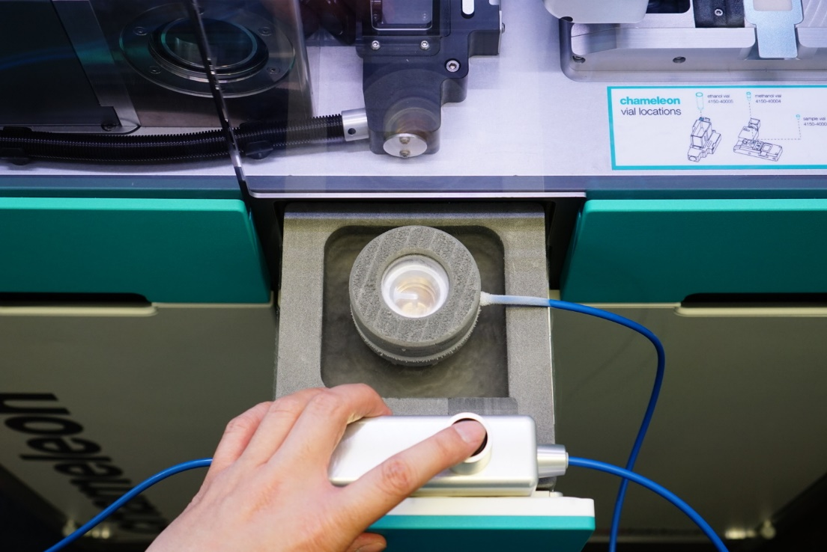
Prepare Grids Workflow
Helium Sparge
Helium Sparge
Setup Dispenser
Setup Dispenser
Test Dispenser
(with water)
Test Dispenser
(with water)
Load Cryogens
Load Cryogens
Place Grid Button
Place Grid Button
Load Grids
Load Grids
Glow Discharge
Glow Discharge
Load Sample
Load Sample
Test Dispenser (with sample)
Test Dispenser (with sample)
Wicking Characterization
Wicking Characterization
Plunge
Plunge
Accept/Reject
Accept/Reject
Clean Dispenser
Clean Dispenser
Test Dispenser (with water)
Test Dispenser (with water)
Dry Dispenser
Dry Dispenser
Remove Cryogens
Remove Cryogens
Finished
Next Grid
Finished
Next Grid
Additional Glow Discharge
Additional Glow Discharge
Cryogen bowl is loaded into the instrument and filled with liquid nitrogen prior to condensing ethane

Slide 10
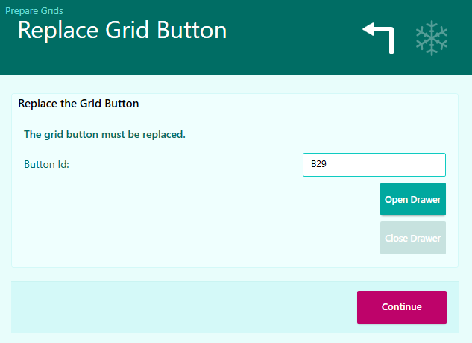
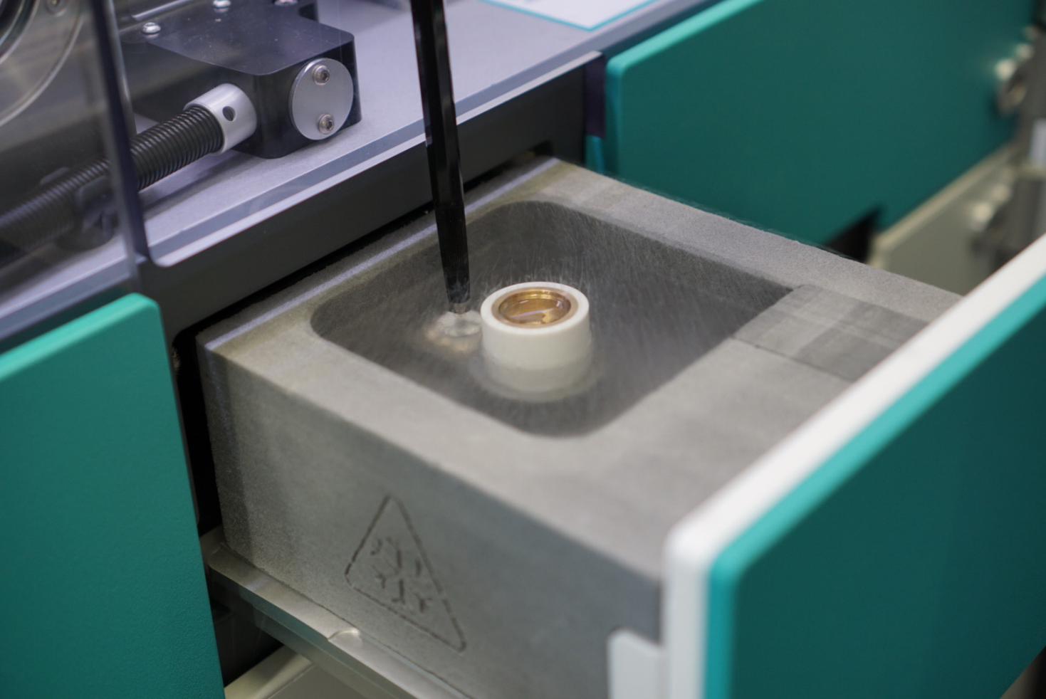
Prepare Grids Workflow
Helium Sparge
Helium Sparge
Setup Dispenser
Setup Dispenser
Test Dispenser
(with water)
Test Dispenser
(with water)
Load Cryogens
Load Cryogens
Place Grid Button
Place Grid Button
Load Grids
Load Grids
Glow Discharge
Glow Discharge
Load Sample
Load Sample
Test Dispenser (with sample)
Test Dispenser (with sample)
Wicking Characterization
Wicking Characterization
Plunge
Plunge
Accept/Reject
Accept/Reject
Clean Dispenser
Clean Dispenser
Test Dispenser (with water)
Test Dispenser (with water)
Dry Dispenser
Dry Dispenser
Remove Cryogens
Remove Cryogens
Finished
Next Grid
Finished
Next Grid
Additional Glow Discharge
Additional Glow Discharge
Loading and naming of the grid storage button

Slide 11
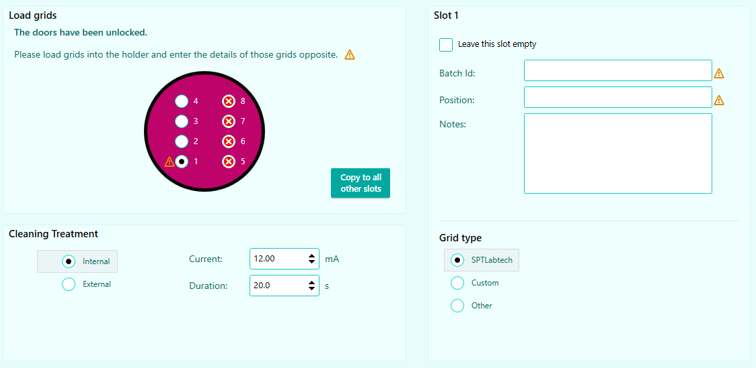
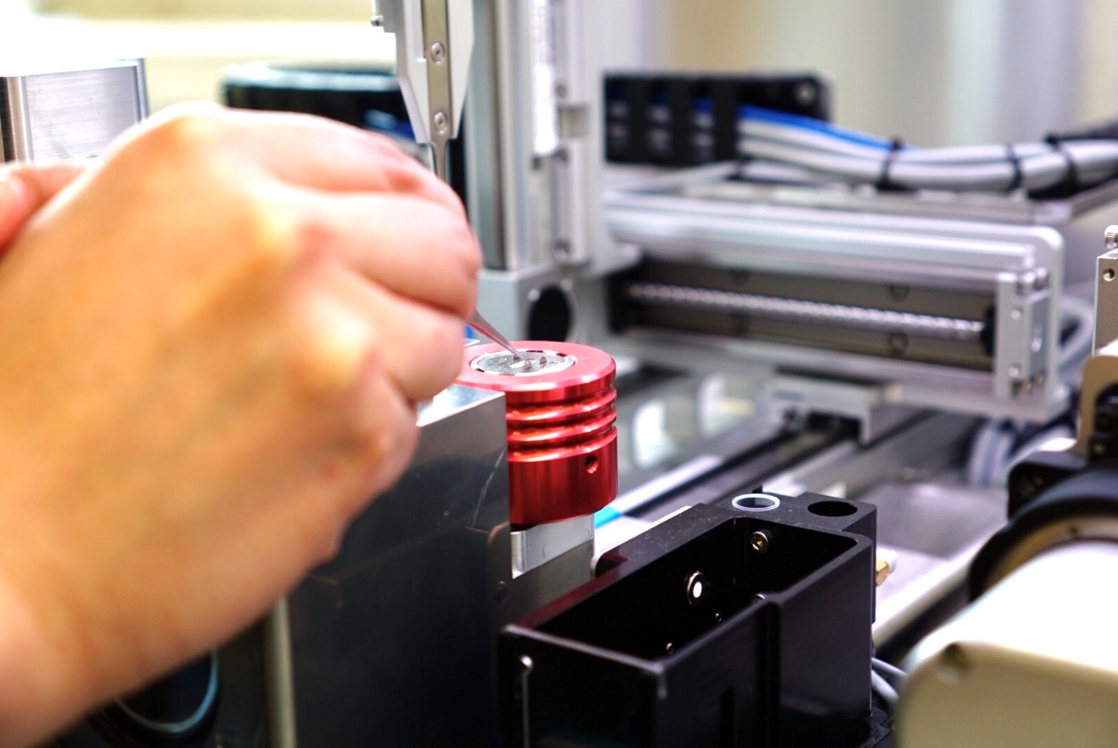
Prepare Grids Workflow
Helium Sparge
Helium Sparge
Setup Dispenser
Setup Dispenser
Test Dispenser
(with water)
Test Dispenser
(with water)
Load Cryogens
Load Cryogens
Place Grid Button
Place Grid Button
Load Grids
Load Grids
Glow Discharge
Glow Discharge
Load Sample
Load Sample
Test Dispenser (with sample)
Test Dispenser (with sample)
Wicking Characterization
Wicking Characterization
Plunge
Plunge
Accept/Reject
Accept/Reject
Clean Dispenser
Clean Dispenser
Test Dispenser (with water)
Test Dispenser (with water)
Dry Dispenser
Dry Dispenser
Remove Cryogens
Remove Cryogens
Finished
Next Grid
Finished
Next Grid
Additional Glow Discharge
Additional Glow Discharge
Loading grids into the system
Enter information about grids
Minimum required: Batch ID and position in the grid box

Slide 12
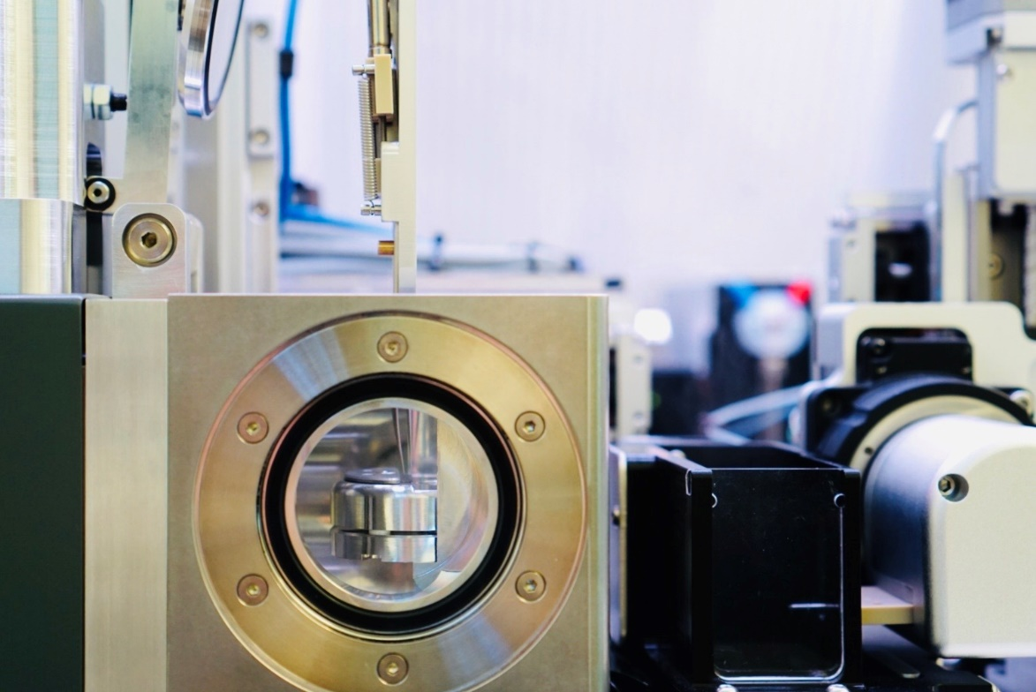
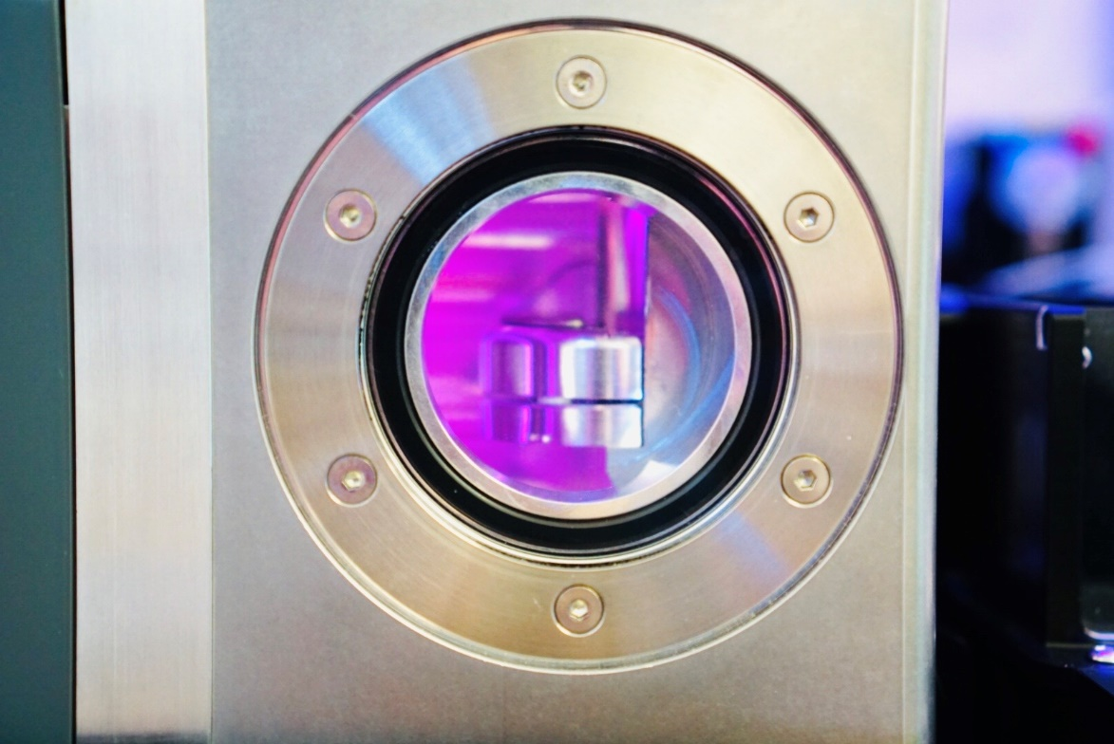
Prepare Grids Workflow
Helium Sparge
Helium Sparge
Setup Dispenser
Setup Dispenser
Test Dispenser
(with water)
Test Dispenser
(with water)
Load Cryogens
Load Cryogens
Place Grid Button
Place Grid Button
Load Grids
Load Grids
Glow Discharge
Glow Discharge
Load Sample
Load Sample
Test Dispenser (with sample)
Test Dispenser (with sample)
Wicking Characterization
Wicking Characterization
Plunge
Plunge
Accept/Reject
Accept/Reject
Clean Dispenser
Clean Dispenser
Test Dispenser (with water)
Test Dispenser (with water)
Dry Dispenser
Dry Dispenser
Remove Cryogens
Remove Cryogens
Finished
Next Grid
Finished
Next Grid
Additional Glow Discharge
Additional Glow Discharge
User can specify the Current and Duration of internal glow discharge.

Slide 13
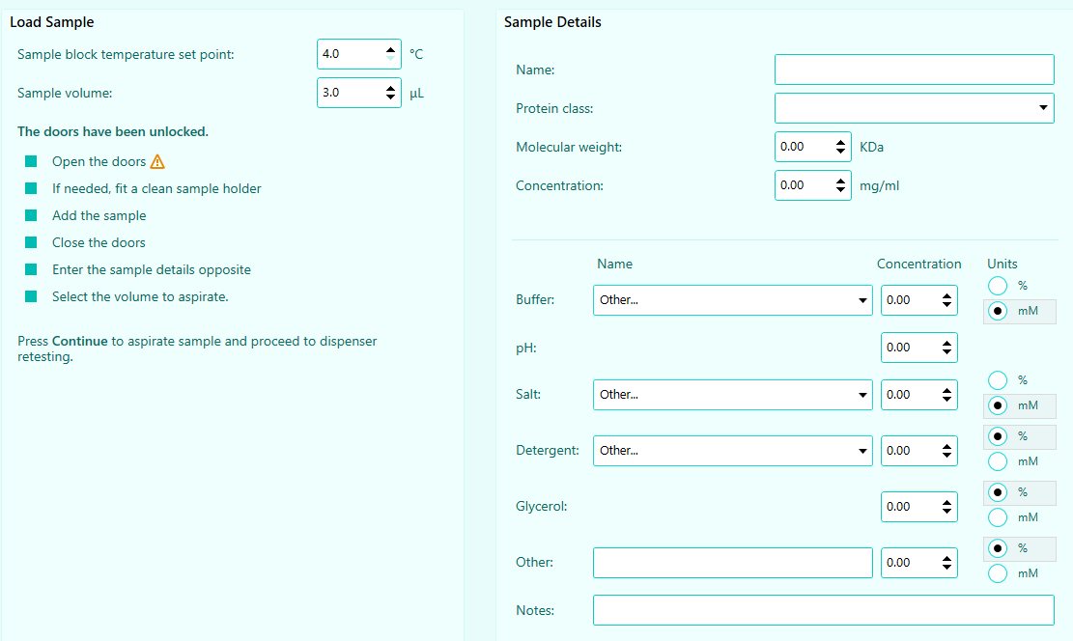
Prepare Grids Workflow
Helium Sparge
Helium Sparge
Setup Dispenser
Setup Dispenser
Test Dispenser
(with water)
Test Dispenser
(with water)
Load Cryogens
Load Cryogens
Place Grid Button
Place Grid Button
Load Grids
Load Grids
Glow Discharge
Glow Discharge
Load Sample
Load Sample
Test Dispenser (with sample)
Test Dispenser (with sample)
Wicking Characterization
Wicking Characterization
Plunge
Plunge
Accept/Reject
Accept/Reject
Clean Dispenser
Clean Dispenser
Test Dispenser (with water)
Test Dispenser (with water)
Dry Dispenser
Dry Dispenser
Remove Cryogens
Remove Cryogens
Finished
Next Grid
Finished
Next Grid
Additional Glow Discharge
Additional Glow Discharge
Pipette sample into sample vial
Enter sample information e.g. protein name, size, concentration and buffer composition
Sample Vial

Slide 14
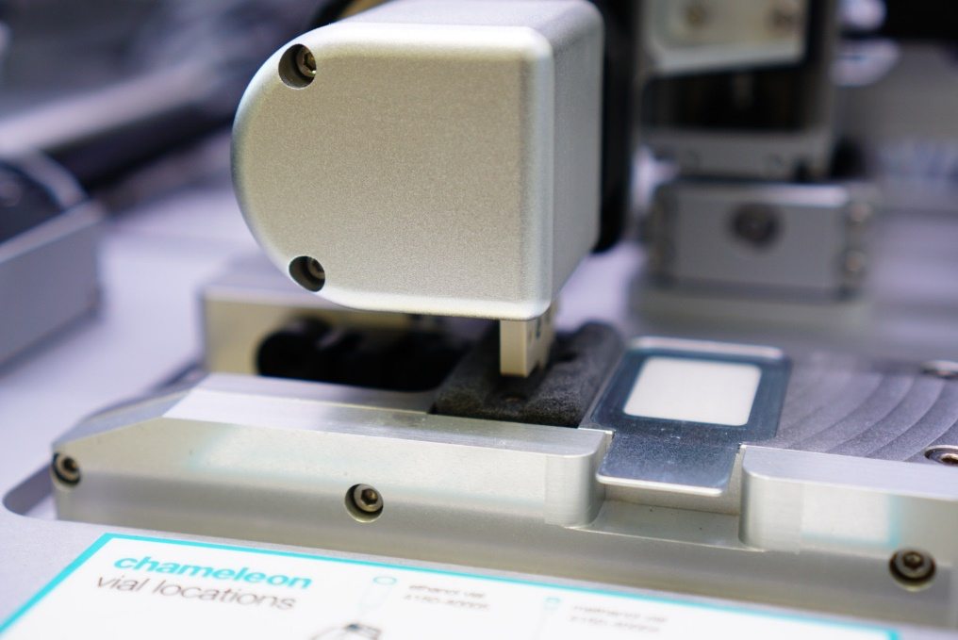
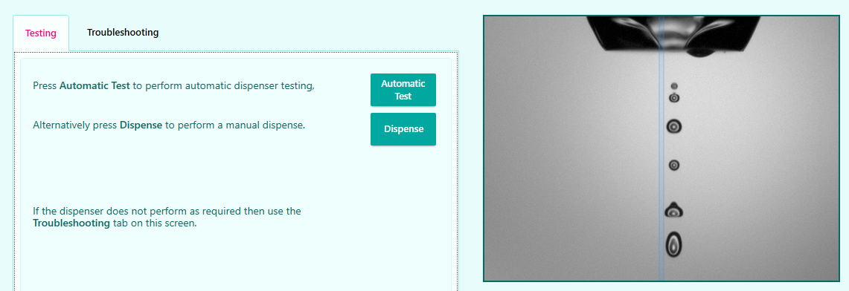
Prepare Grids Workflow
Helium Sparge
Helium Sparge
Setup Dispenser
Setup Dispenser
Test Dispenser
(with water)
Test Dispenser
(with water)
Load Cryogens
Load Cryogens
Place Grid Button
Place Grid Button
Load Grids
Load Grids
Glow Discharge
Glow Discharge
Load Sample
Load Sample
Test Dispenser (with sample)
Test Dispenser (with sample)
Wicking Characterization
Wicking Characterization
Plunge
Plunge
Accept/Reject
Accept/Reject
Clean Dispenser
Clean Dispenser
Test Dispenser (with water)
Test Dispenser (with water)
Dry Dispenser
Dry Dispenser
Remove Cryogens
Remove Cryogens
Finished
Next Grid
Finished
Next Grid
Additional Glow Discharge
Additional Glow Discharge
Dispenser will aspirate sample from sample vial
Test the dispense with sample
Dispensing pattern will likely be different with sample than with water
The dispenses should be vertical and consistent. Use the Troubleshooting tab if needed.

Slide 15
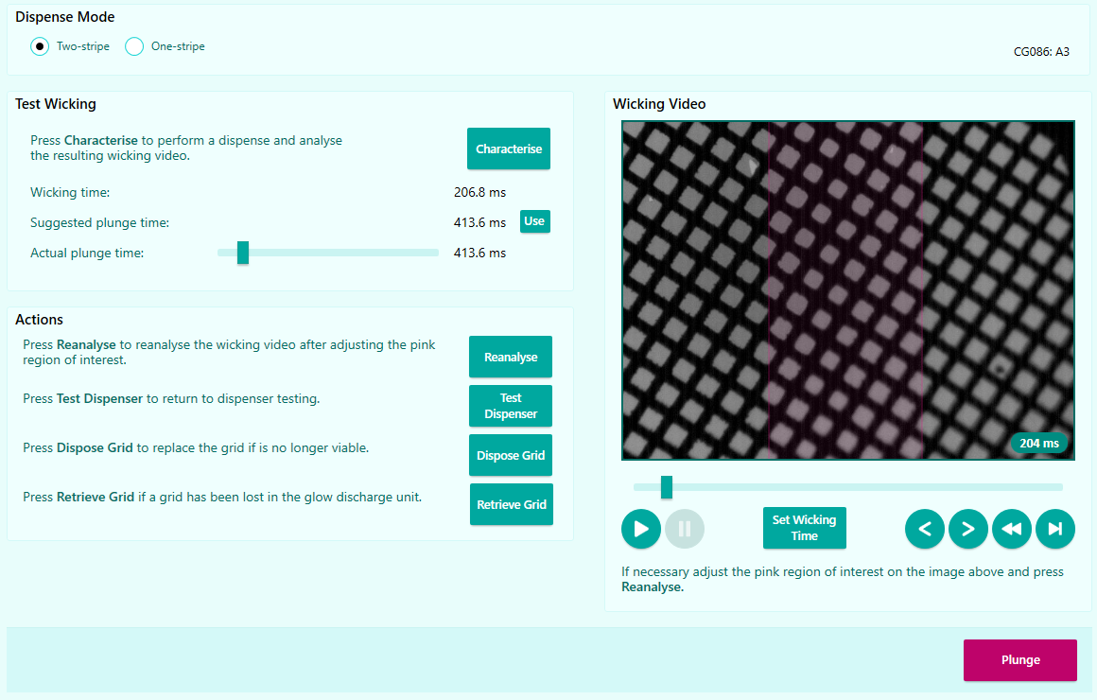
Prepare Grids Workflow
Helium Sparge
Helium Sparge
Setup Dispenser
Setup Dispenser
Test Dispenser
(with water)
Test Dispenser
(with water)
Load Cryogens
Load Cryogens
Place Grid Button
Place Grid Button
Load Grids
Load Grids
Glow Discharge
Glow Discharge
Load Sample
Load Sample
Test Dispenser (with sample)
Test Dispenser (with sample)
Wicking Characterization
Wicking Characterization
Plunge
Plunge
Accept/Reject
Accept/Reject
Clean Dispenser
Clean Dispenser
Test Dispenser (with water)
Test Dispenser (with water)
Dry Dispenser
Dry Dispenser
Remove Cryogens
Remove Cryogens
Finished
Next Grid
Finished
Next Grid
Additional Glow Discharge
Additional Glow Discharge
Two-stripe Dispense Mode
Wicking characterization stripe
To determine the appropriate wicking time for a particular grid and sample
Plunge stripe
To freeze grid based on the wicking time determined using the wicking characterization stripe

Slide 16
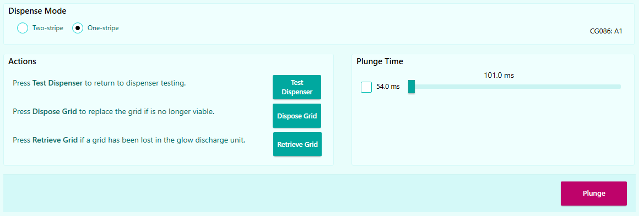
Prepare Grids Workflow
Helium Sparge
Helium Sparge
Setup Dispenser
Setup Dispenser
Test Dispenser
(with water)
Test Dispenser
(with water)
Load Cryogens
Load Cryogens
Place Grid Button
Place Grid Button
Load Grids
Load Grids
Glow Discharge
Glow Discharge
Load Sample
Load Sample
Test Dispenser (with sample)
Test Dispenser (with sample)
Wicking Characterization
Wicking Characterization
Plunge
Plunge
Accept/Reject
Accept/Reject
Clean Dispenser
Clean Dispenser
Test Dispenser (with water)
Test Dispenser (with water)
Dry Dispenser
Dry Dispenser
Remove Cryogens
Remove Cryogens
Finished
Next Grid
Finished
Next Grid
Additional Glow Discharge
Additional Glow Discharge
One-stripe Dispense Mode
Plunge stripe
To freeze grid based on parameters determined using the two-stripe protocol

Slide 17
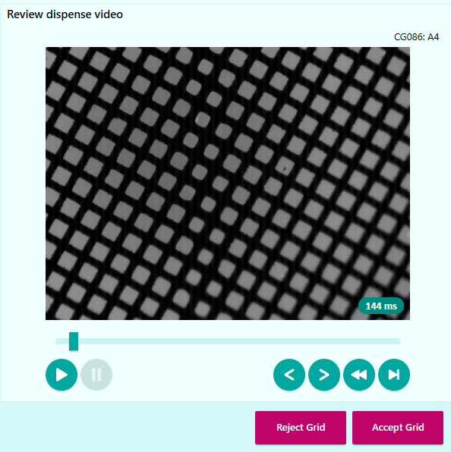
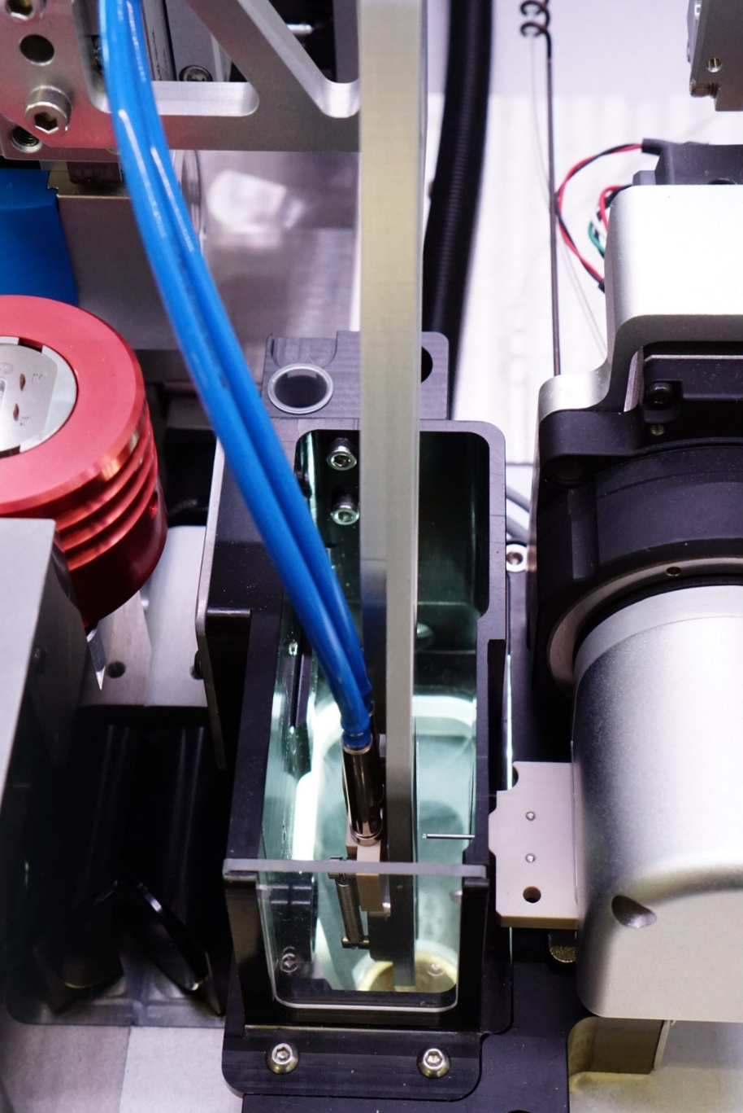
Prepare Grids Workflow
Helium Sparge
Helium Sparge
Setup Dispenser
Setup Dispenser
Test Dispenser
(with water)
Test Dispenser
(with water)
Load Cryogens
Load Cryogens
Place Grid Button
Place Grid Button
Load Grids
Load Grids
Glow Discharge
Glow Discharge
Load Sample
Load Sample
Test Dispenser (with sample)
Test Dispenser (with sample)
Wicking Characterization
Wicking Characterization
Plunge
Plunge
Accept/Reject
Accept/Reject
Clean Dispenser
Clean Dispenser
Test Dispenser (with water)
Test Dispenser (with water)
Dry Dispenser
Dry Dispenser
Remove Cryogens
Remove Cryogens
Finished
Next Grid
Finished
Next Grid
Additional Glow Discharge
Additional Glow Discharge
Based on the degree of wicking observed, decide whether to Accept Grid or Reject Grid

Slide 18
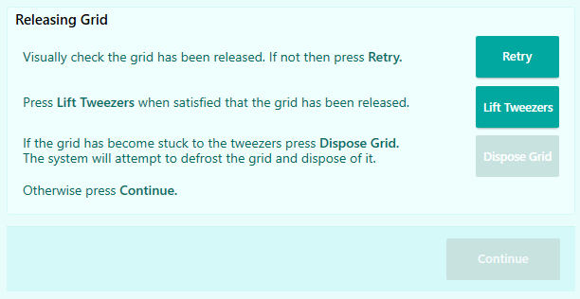
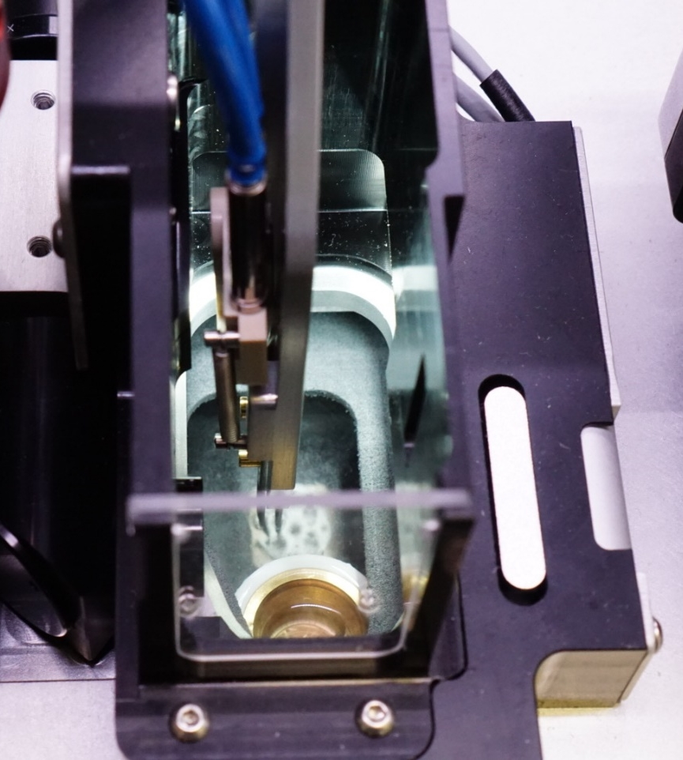
Prepare Grids Workflow
Helium Sparge
Setup Dispenser
Test Dispenser
(with water)
Load Cryogens
Place Grid Button
Load Grids
Glow Discharge
Load Sample
Test Dispenser (with sample)
Wicking Characterization
Plunge
Accept/Reject
Next Grid
Clean Dispenser
Test Dispenser (with water)
Dry Dispenser
Remove Cryogens
Finished
Additional Glow Discharge
If you decide to accept the grid, tweezers will put the grid into the button
Visually check the grid has been released into the button

Slide 19
Prepare Grids Workflow
Helium Sparge
Setup Dispenser
Test Dispenser
(with water)
Load Cryogens
Place Grid Button
Load Grids
Glow Discharge
Load Sample
Test Dispenser (with sample)
Wicking Characterization
Plunge
Accept/Reject
Next Grid
Clean Dispenser
Test Dispenser (with water)
Dry Dispenser
Remove Cryogens
Finished
Additional Glow Discharge
Provide an assessment of the grid

Slide 20
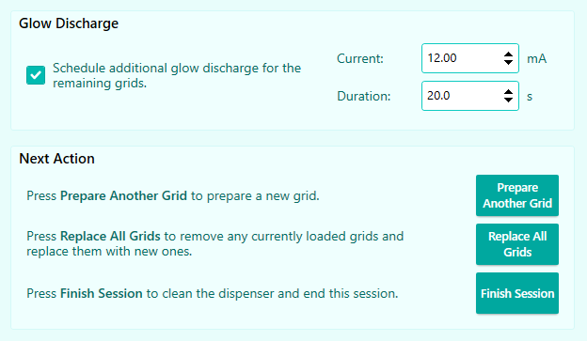
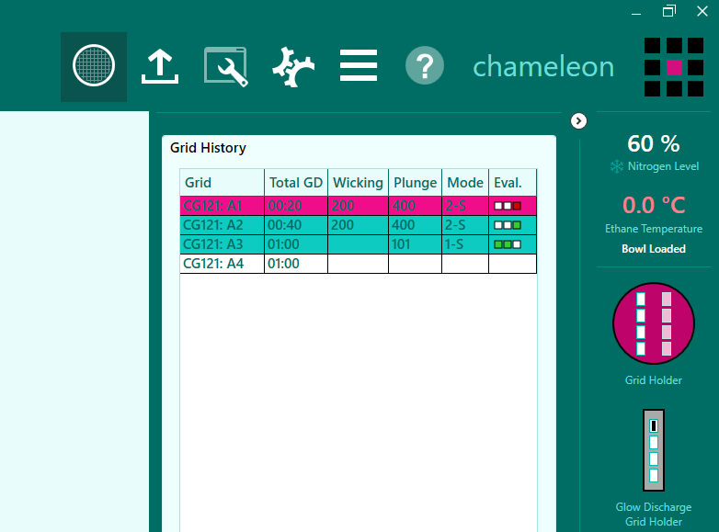
Prepare Grids Workflow
Helium Sparge
Setup Dispenser
Test Dispenser
(with water)
Load Cryogens
Place Grid Button
Load Grids
Glow Discharge
Load Sample
Test Dispenser (with sample)
Wicking Characterization
Plunge
Accept/Reject
Next Grid
Clean Dispenser
Test Dispenser (with water)
Dry Dispenser
Remove Cryogens
Finished
Additional Glow Discharge
Additional glow discharge can be applied to grids remaining in the glow discharger
Grid History flip out panel tracks and displays information on grids frozen in the current session to make scheduling additional glow discharge or planning for next grids easier.

Slide 21
Prepare Grids Workflow
Helium Sparge
Helium Sparge
Setup Dispenser
Setup Dispenser
Test Dispenser
(with water)
Test Dispenser
(with water)
Load Cryogens
Load Cryogens
Place Grid Button
Place Grid Button
Load Grids
Load Grids
Glow Discharge
Glow Discharge
Load Sample
Load Sample
Test Dispenser (with sample)
Test Dispenser (with sample)
Wicking Characterization
Wicking Characterization
Plunge
Plunge
Accept/Reject
Accept/Reject
Clean Dispenser
Clean Dispenser
Test Dispenser (with water)
Test Dispenser (with water)
Dry Dispenser
Dry Dispenser
Remove Cryogens
Remove Cryogens
Finished
Next Grid
Finished
Next Grid
Additional Glow Discharge
Additional Glow Discharge
Choose the next actions

Slide 22
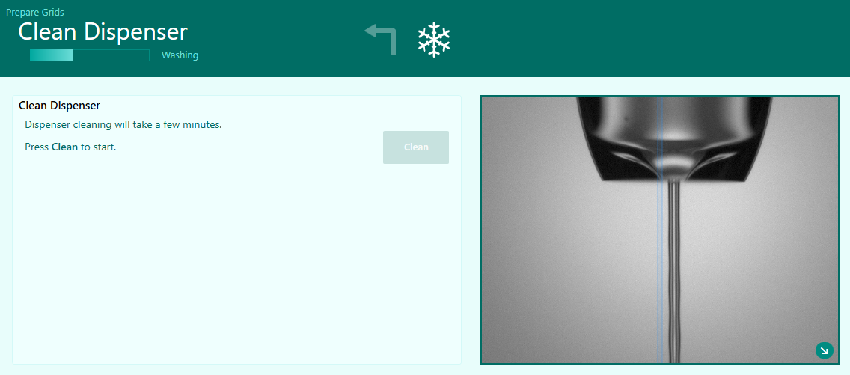
Prepare Grids Workflow
Helium Sparge
Helium Sparge
Setup Dispenser
Setup Dispenser
Test Dispenser
(with water)
Test Dispenser
(with water)
Load Cryogens
Load Cryogens
Place Grid Button
Place Grid Button
Load Grids
Load Grids
Glow Discharge
Glow Discharge
Load Sample
Load Sample
Test Dispenser (with sample)
Test Dispenser (with sample)
Wicking Characterization
Wicking Characterization
Plunge
Plunge
Accept/Reject
Accept/Reject
Clean Dispenser
Clean Dispenser
Test Dispenser (with water)
Test Dispenser (with water)
Dry Dispenser
Dry Dispenser
Remove Cryogens
Remove Cryogens
Finished
Next Grid
Finished
Next Grid
Additional Glow Discharge
Additional Glow Discharge
Dispenser will be automatically cleaned using ChamClean and water
ChamClean
water

Slide 23
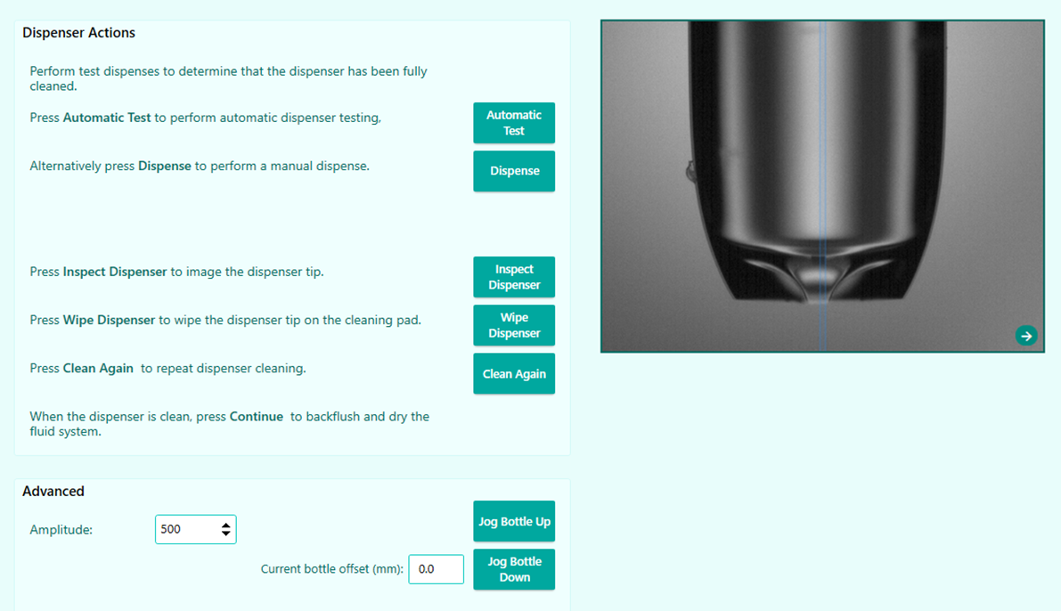
Prepare Grids Workflow
Helium Sparge
Helium Sparge
Setup Dispenser
Setup Dispenser
Test Dispenser
(with water)
Test Dispenser
(with water)
Load Cryogens
Load Cryogens
Place Grid Button
Place Grid Button
Load Grids
Load Grids
Glow Discharge
Glow Discharge
Load Sample
Load Sample
Test Dispenser (with sample)
Test Dispenser (with sample)
Wicking Characterization
Wicking Characterization
Plunge
Plunge
Accept/Reject
Accept/Reject
Clean Dispenser
Clean Dispenser
Test Dispenser (with water)
Test Dispenser (with water)
Dry Dispenser
Dry Dispenser
Remove Cryogens
Remove Cryogens
Finished
Next Grid
Finished
Next Grid
Additional Glow Discharge
Additional Glow Discharge
A water dispense is performed to check cleaning has restored dispenser performance
Check dispensing pattern is vertical and consistent
If needed, the cleaning procedure can be repeated

Slide 24
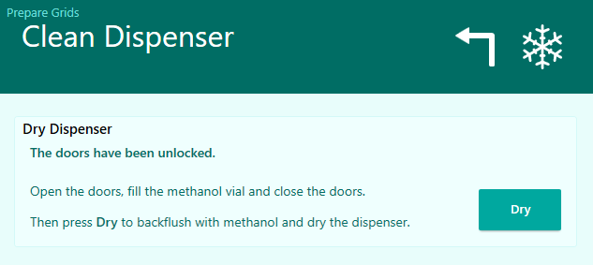
Prepare Grids Workflow
Helium Sparge
Helium Sparge
Setup Dispenser
Setup Dispenser
Test Dispenser
(with water)
Test Dispenser
(with water)
Load Cryogens
Load Cryogens
Place Grid Button
Place Grid Button
Load Grids
Load Grids
Glow Discharge
Glow Discharge
Load Sample
Load Sample
Test Dispenser (with sample)
Test Dispenser (with sample)
Wicking Characterization
Wicking Characterization
Plunge
Plunge
Accept/Reject
Accept/Reject
Clean Dispenser
Clean Dispenser
Test Dispenser (with water)
Test Dispenser (with water)
Dry Dispenser
Dry Dispenser
Remove Cryogens
Remove Cryogens
Finished
Next Grid
Finished
Next Grid
Additional Glow Discharge
Additional Glow Discharge
The dispenser should be kept dry when not in use. A methanol backflush is used to dry the dispenser.
Methanol Vial

Slide 25
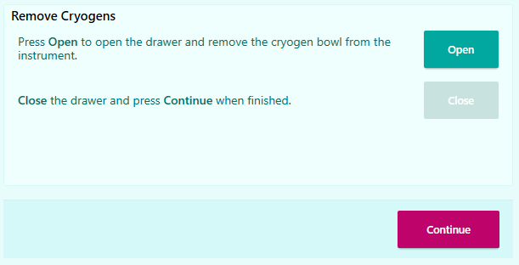
Prepare Grids Workflow
Helium Sparge
Helium Sparge
Setup Dispenser
Setup Dispenser
Test Dispenser
(with water)
Test Dispenser
(with water)
Load Cryogens
Load Cryogens
Place Grid Button
Place Grid Button
Load Grids
Load Grids
Glow Discharge
Glow Discharge
Load Sample
Load Sample
Test Dispenser (with sample)
Test Dispenser (with sample)
Wicking Characterization
Wicking Characterization
Plunge
Plunge
Accept/Reject
Accept/Reject
Clean Dispenser
Clean Dispenser
Test Dispenser (with water)
Test Dispenser (with water)
Dry Dispenser
Dry Dispenser
Remove Cryogens
Remove Cryogens
Finished
Next Grid
Finished
Next Grid
Additional Glow Discharge
Additional Glow Discharge
The cryogen bowl and frozen grids can now be removed from the instrument
The cryogens should be disposed of in accordance with site health and safety guidelines
The cryogen bowl must not stay in the instrument while the cryogens evaporate, therefore the system will not allow the user to move past this screen until it has detected that the cryogen bowl has been removed.

Slide 26
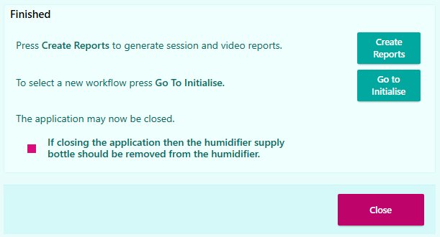
Prepare Grids Workflow
Helium Sparge
Helium Sparge
Setup Dispenser
Setup Dispenser
Test Dispenser
(with water)
Test Dispenser
(with water)
Load Cryogens
Load Cryogens
Place Grid Button
Place Grid Button
Load Grids
Load Grids
Glow Discharge
Glow Discharge
Load Sample
Load Sample
Test Dispenser (with sample)
Test Dispenser (with sample)
Wicking Characterization
Wicking Characterization
Plunge
Plunge
Accept/Reject
Accept/Reject
Clean Dispenser
Clean Dispenser
Test Dispenser (with water)
Test Dispenser (with water)
Dry Dispenser
Dry Dispenser
Remove Cryogens
Remove Cryogens
Finished
Next Grid
Finished
Next Grid
Additional Glow Discharge
Additional Glow Discharge
The workflow is finished, and the application may now be safely closed
Session reports and videos can be generated, or a new session initiated
If finished, the humidifier supply bottle should be removed from the humidifier

Slide 27
Clean Dispenser Workflow

Slide 28
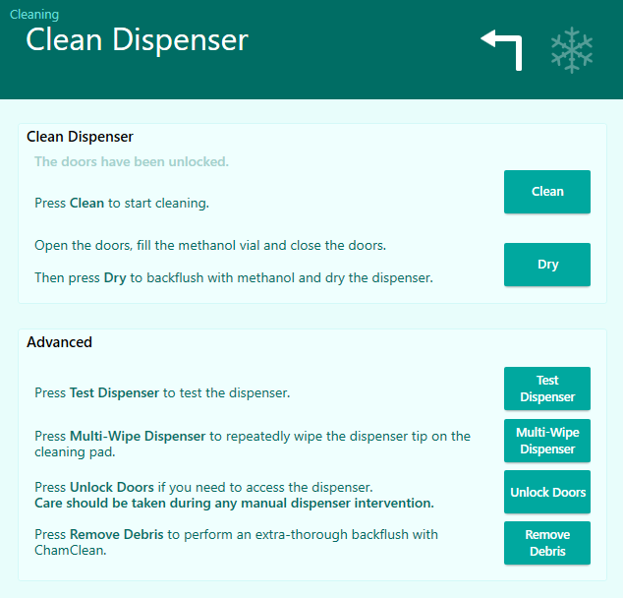
Clean Dispenser Workflow
Press Clean to perform additional dispenser cleaning to restore dispenser performance
Use Test Dispenser to perform water test dispenses to verify dispenser performance
The dispenser should be kept dry when not in use. Press Dry to perform a methanol backflush before finishing the workflow.

Slide 29
Retrieve Grids Workflow

Slide 30
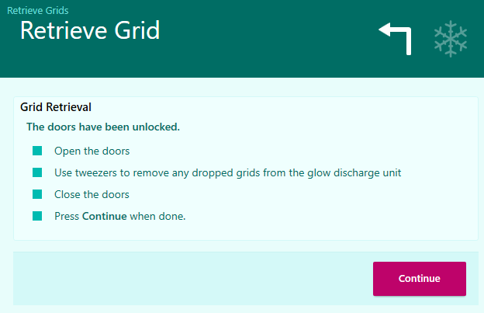
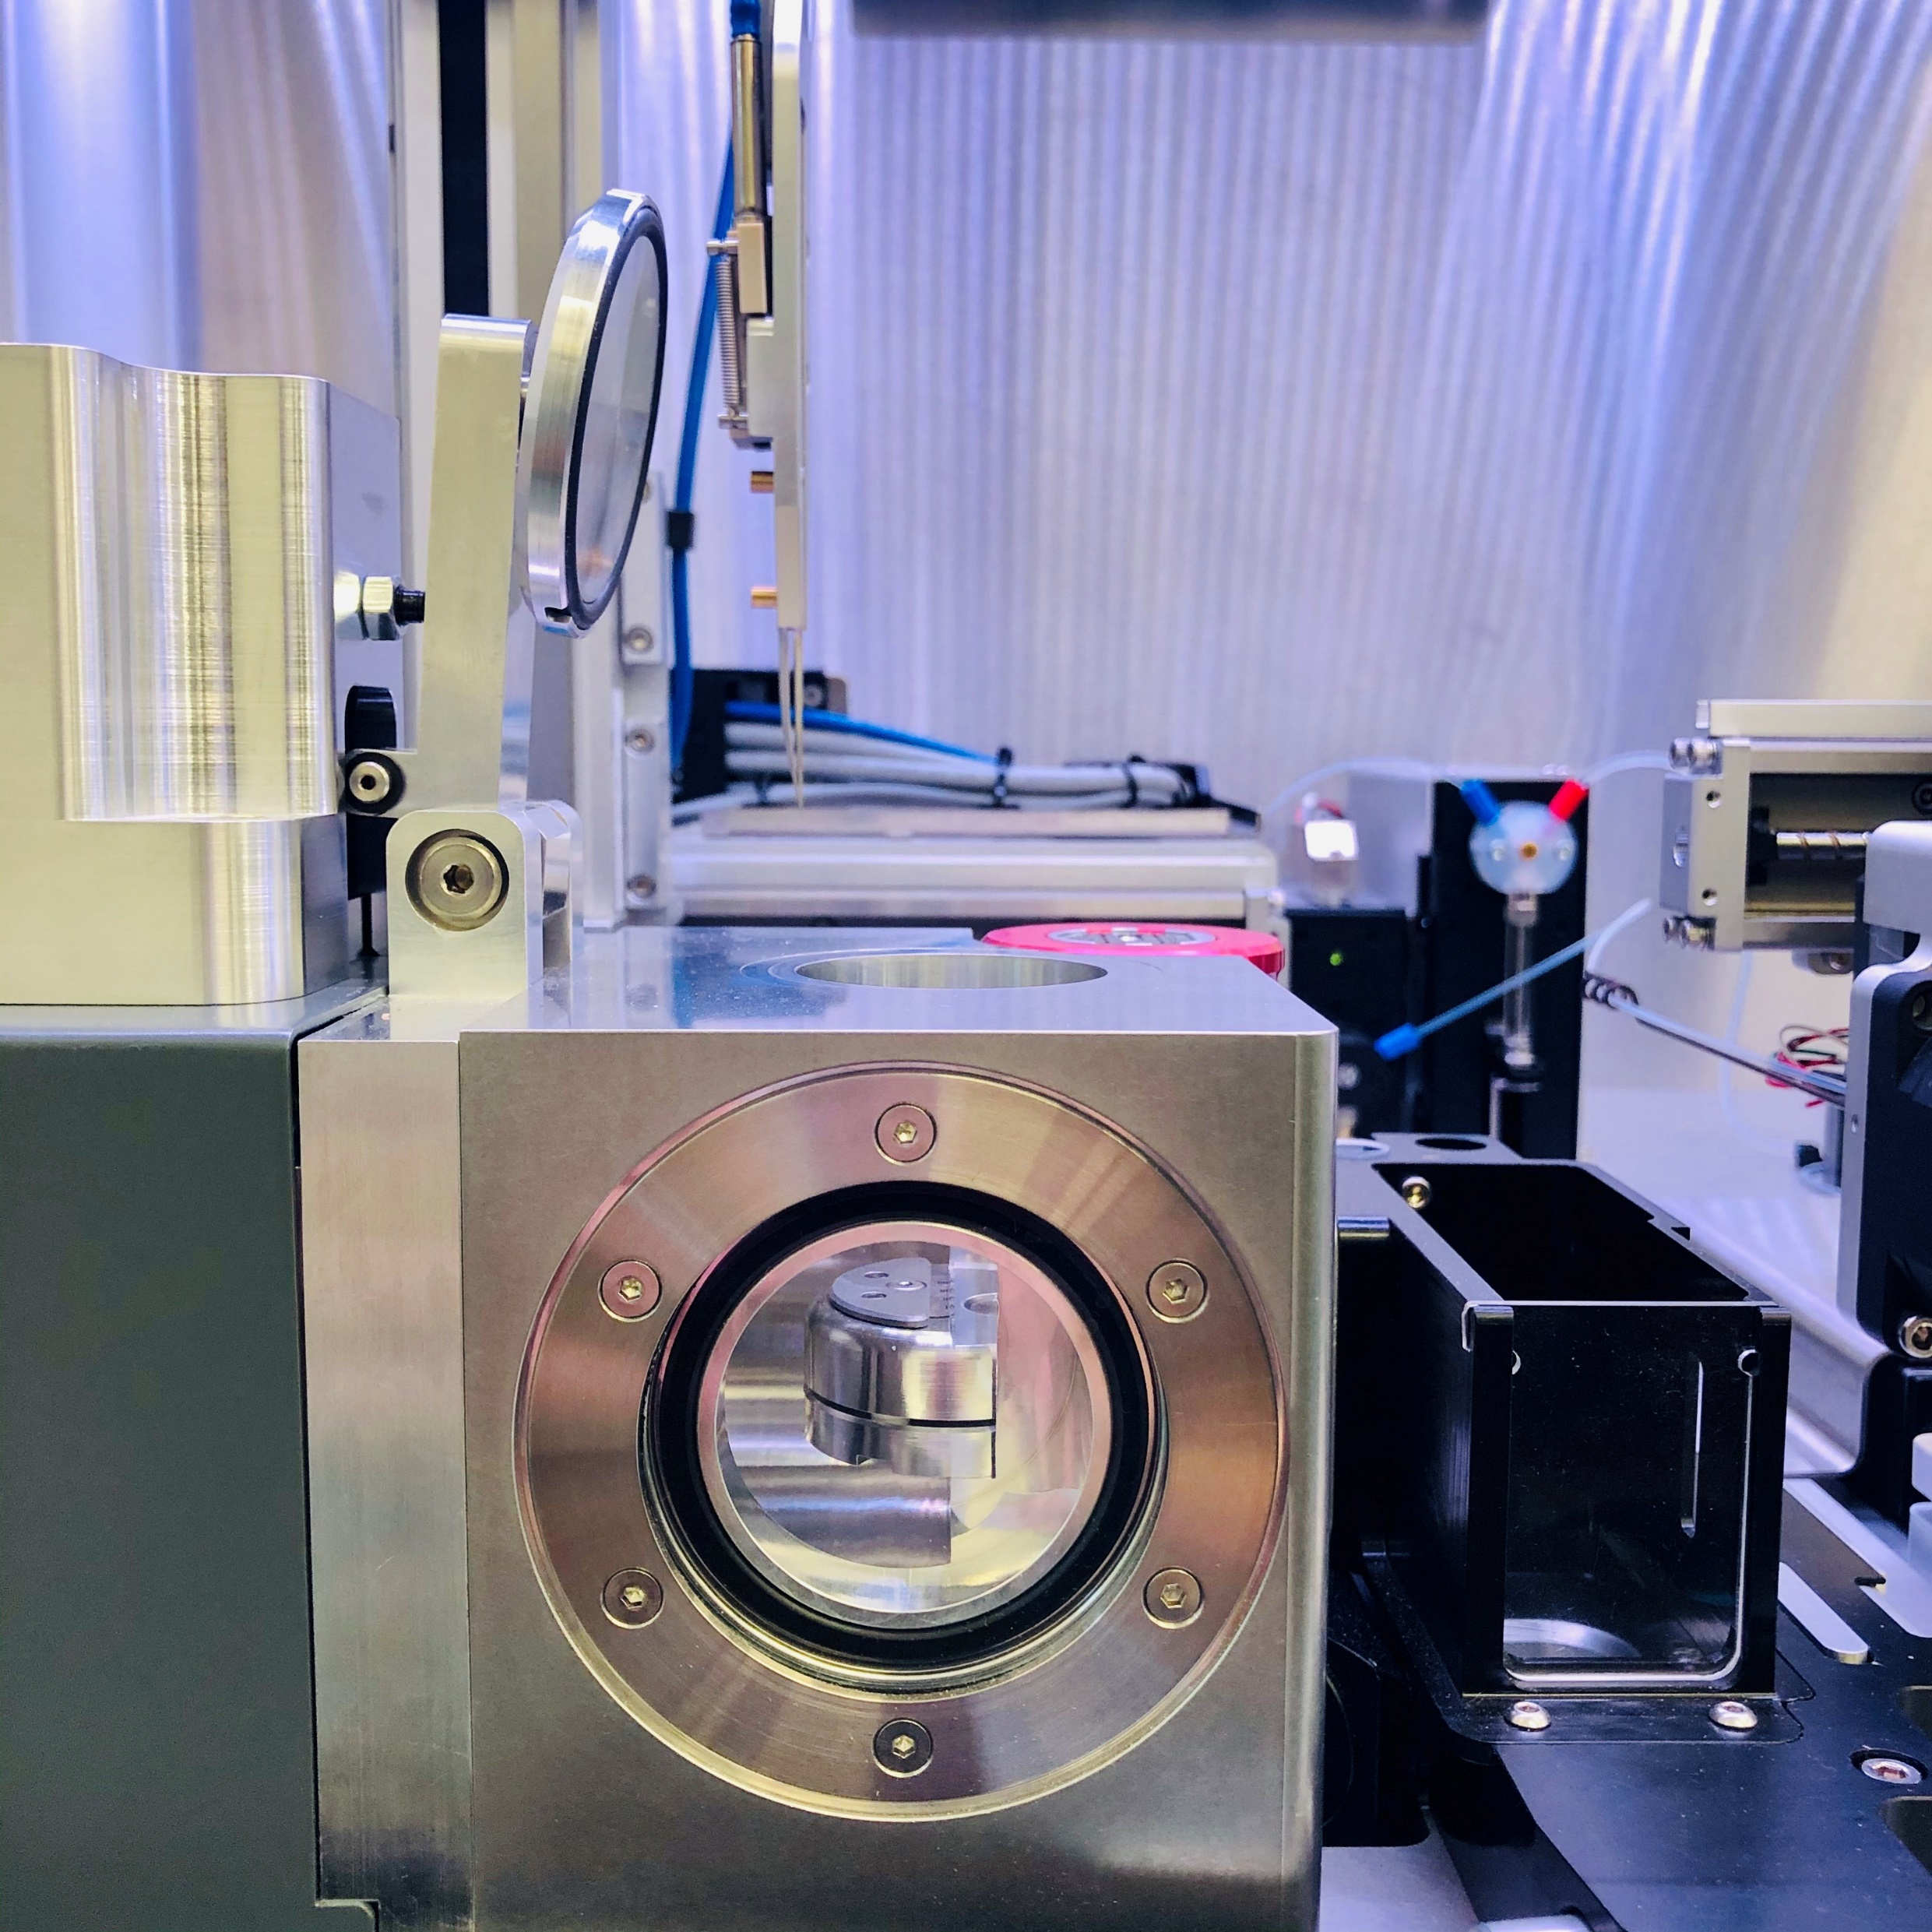
Retrieve Grids Workflow
Doors will be unlocked and glow discharger will open the lid for user to manually remove dropped grids

Slide 31
Summary

Slide 32
Key Points
chameleon has 3 workflows:
Prepare grids – plunge freeze with sample
Clean dispenser – additional dispenser cleaning routines
Retrieve grids – retrieve any grids dropped in the internal glow discharger
Dispenser:
When dispensing water, the dispense should be vertical and consistent.
Dispenser issues identified when dispensing water will be magnified when dispensing samples. Issues should be resolved before aspirating sample.
The dispenser is retested after sample has been aspirated. The dispensing pattern will likely be different (less vertical and less consistent). This is expected and is okay.
After cleaning, the dispenser is tested again to check that the dispenser condition has been restored. Issues should be resolved if found during this step.
The dispenser needs to be kept dry when not in use.
Freezing:
There are two dispense modes for freezing a grid: two-stripe and one-stripe.
Cryogens:
Cryogens can be removed only after cleaning to comply with health and safety guidelines

Slide 33
Quiz
What should a user look for when performing test dispenses with water?
Droplets are vertical
Positions of droplets remain consistent between multiple dispenses
Droplets are rounded
Spacing between each droplet is the same
Will dispense pattern observed with water be the same as with sample?
Yes
No
Which workflow should be used when the performance of the dispenser has deteriorated?
Prepare Grids
Clean Dispenser
At what point can I transfer my frozen grids from chameleon in order to clip them?
Immediately after the last grid in the freezing session has been frozen on chameleon
While the dispenser is being cleaned
After dispenser cleaning is complete and the cryogen bowl has been removed from the chameleon
After the software has been closed and the instrument is turned off

Slide 34
Quiz
What should a user look for when performing test dispenses with water?
Droplets are vertical
Positions of droplets remain consistent between multiple dispenses
Droplets are rounded
Spacing between each droplet is the same
Will dispense pattern observed with water be the same as with sample?
Yes
No
Which workflow should be used when the performance of the dispenser has deteriorated?
Prepare Grids
Clean Dispenser
At what point can I transfer my frozen grids from chameleon in order to clip them?
Immediately after the last grid in the freezing session has been frozen on chameleon
While the dispenser is being cleaned
After dispenser cleaning is complete and the cryogen bowl has been removed from the chameleon
After the software has been closed and the instrument is turned off

