Slide 1
Ethane Condensing on chameleon
chameleon v1.11

Slide 2
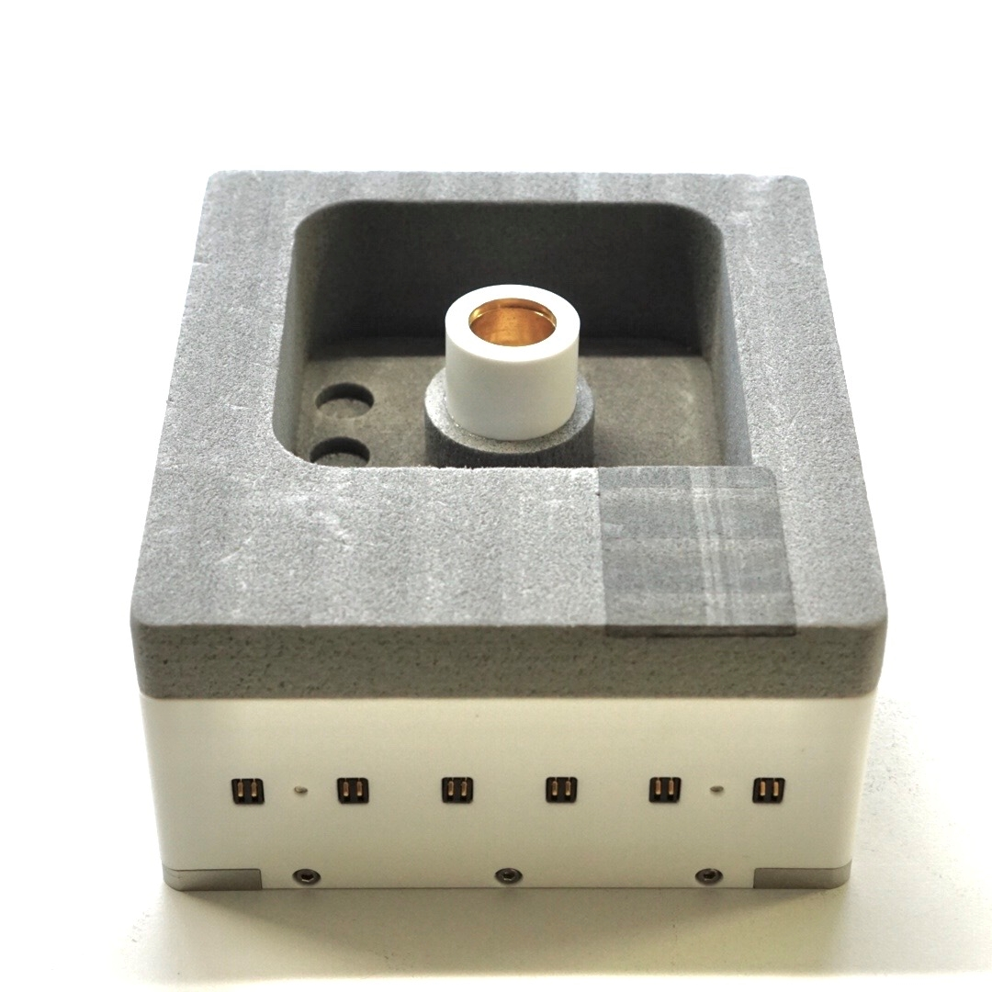
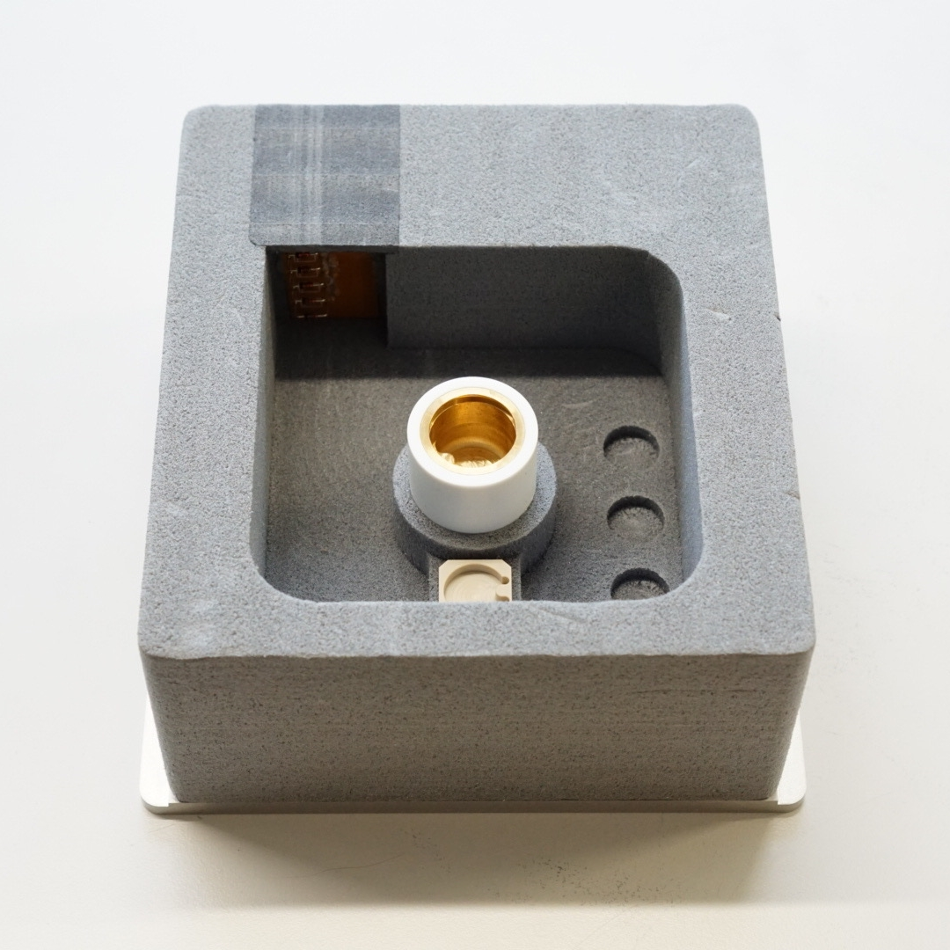
Cryogen Bowl
LN2 sensor
Temp controlled ethane cup
Button storage area
Button holder
Electrical contacts for cryogen drawer

Slide 3
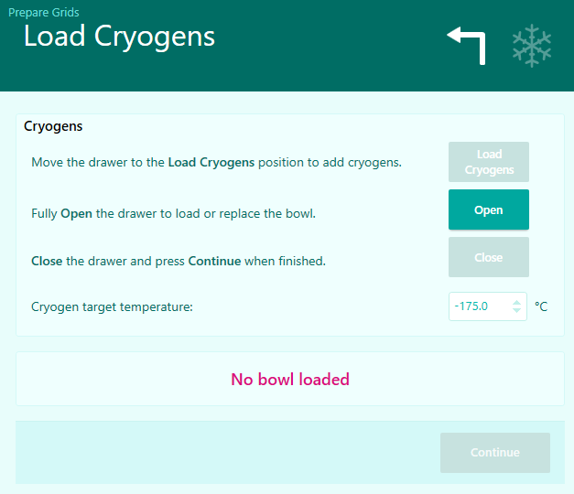
1. Put Cryogen Bowl into Drawer
Press “Open” to open the cryogen drawer

Slide 4
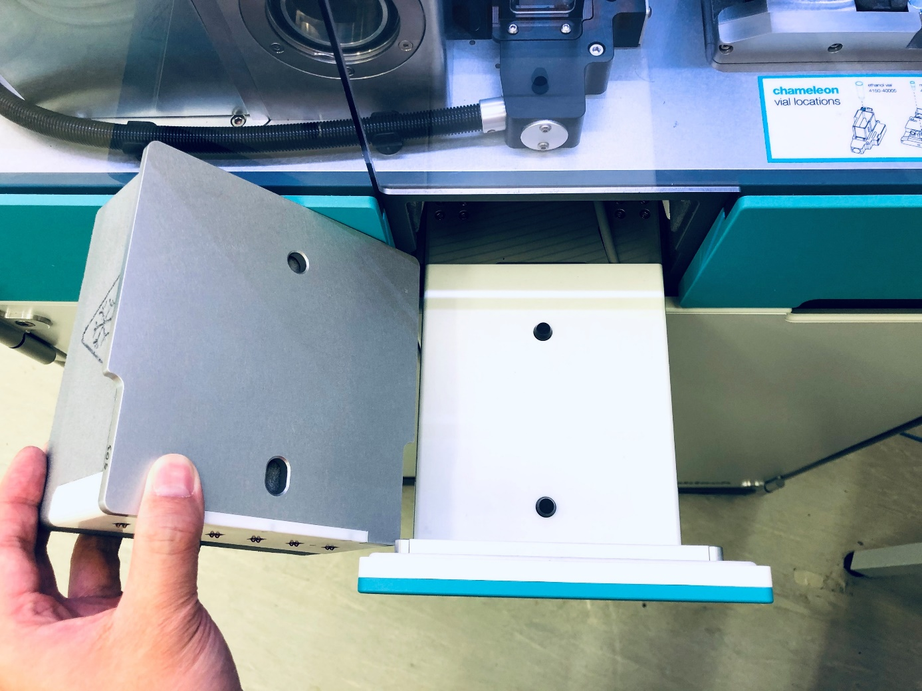
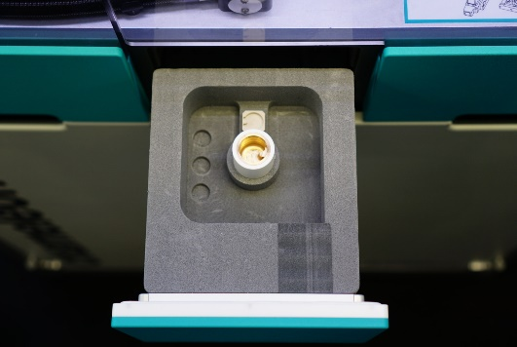
1. Put Cryogen Bowl into Drawer
Place the cryogen bowl into the opened drawer by matching up the pins on the drawer with pinholes at the bottom of the bowl and placing the bowl straight down onto them.

Slide 5
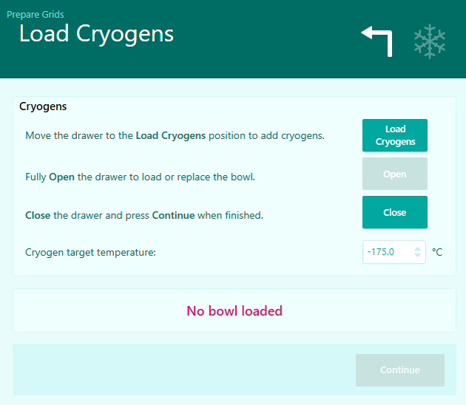
2. Cool Down Cryogen Bowl
Once the cryogen bowl has been placed inside the drawer, press Load Cryogens.
The drawer will partially retract and detect the presence of the cryogen bowl.

Slide 6
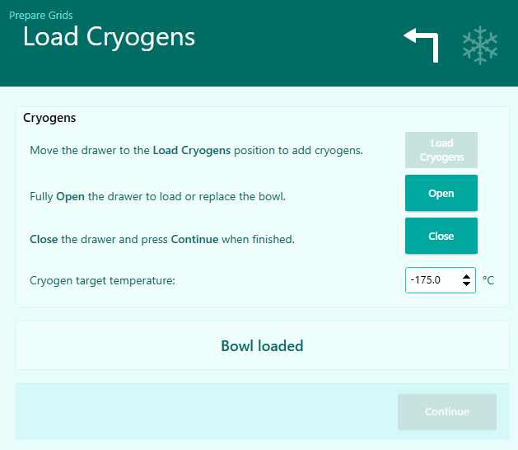
2. Cool Down Cryogen Bowl
The Bowl Status will change from No Bowl Loaded to Bowl Loaded.
On the side panel of the user interface, the instrument will now provide a reading for Ethane Temperature and Nitrogen Level and the ethane temperature control will now be active..

Slide 7
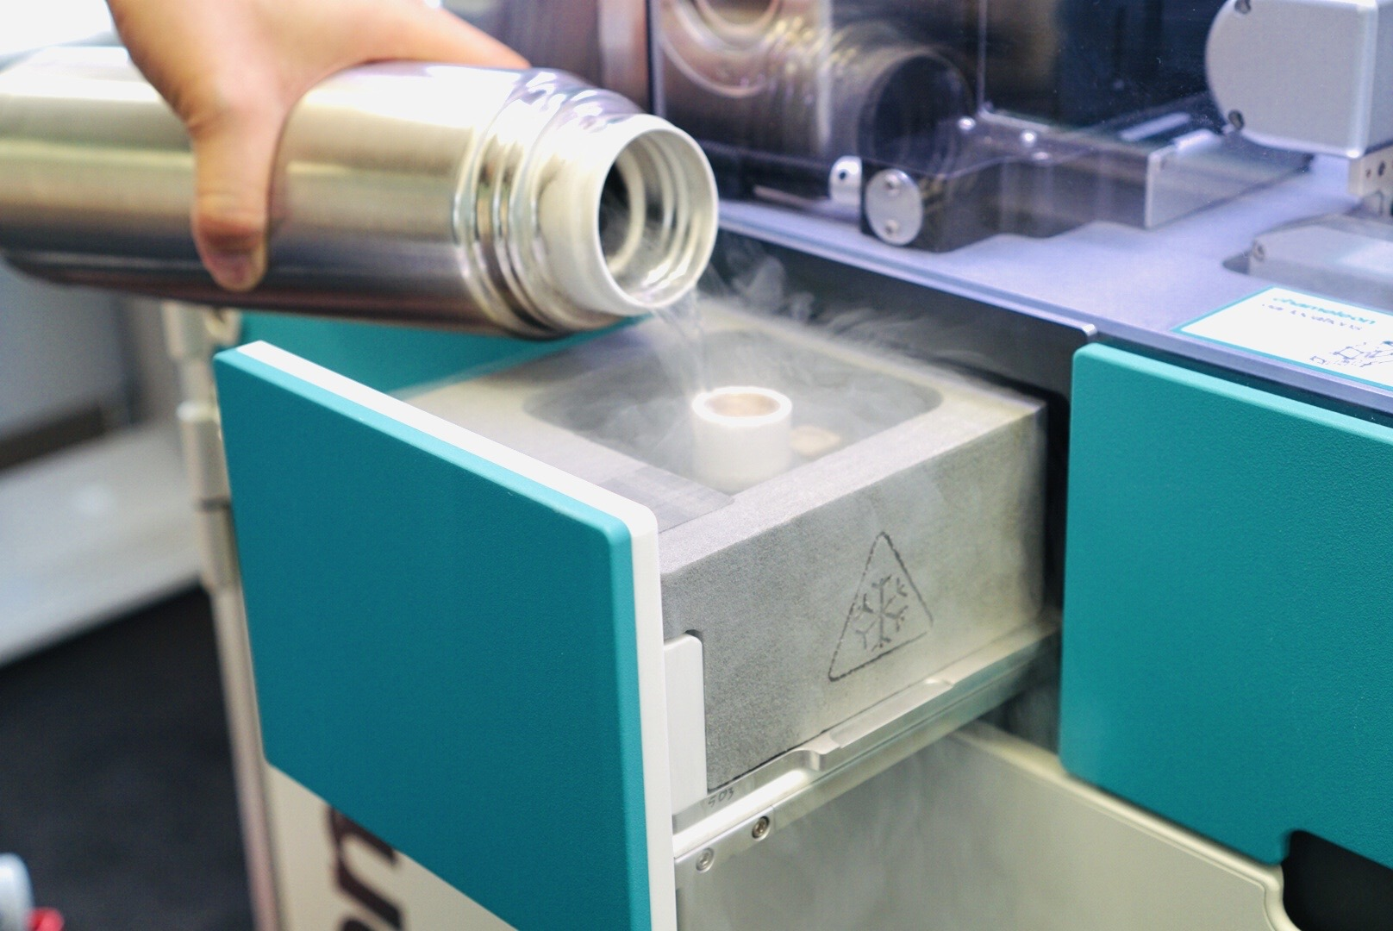
2. Cool Down Cryogen Bowl
Fill the bowl and ethane cup with liquid nitrogen. Wait until the ethane cup cools to liquid nitrogen temperature.

Slide 8
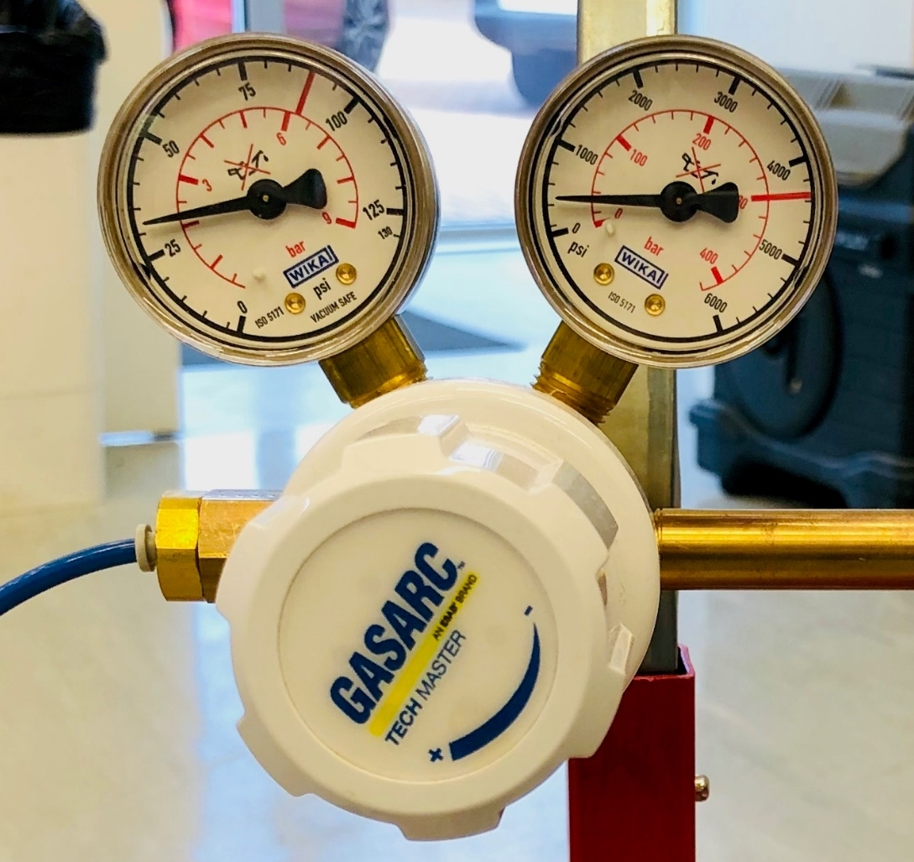
3. Open the ethane gas valve
Open the ethane gas tank and check that the final pressure regulator is set to 2 bar (29psi)
Once set, do not adjust the regulator as this will affect timing

Slide 9
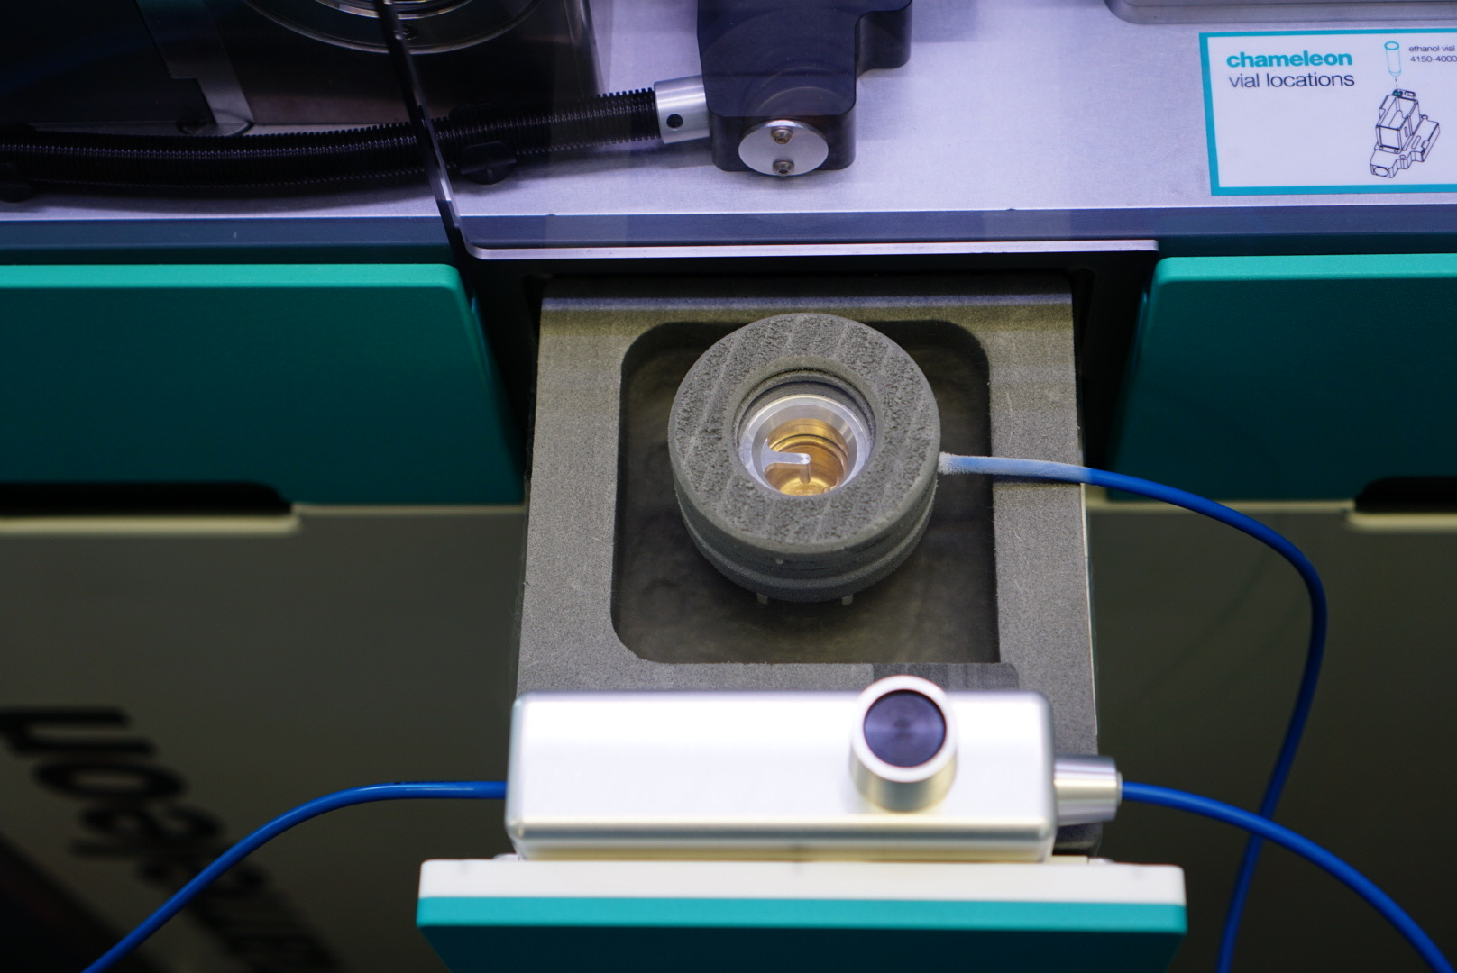
4. Cool Down Ethane Condensing Head
Ethane condensing head
Ethane flow controller
Place ethane condensing head over the ethane cup, ensuring it is fully seated and hoses are not wrapped around the drawer
Wait for the ethane condensing head to cool to liquid nitrogen temperature.
Before proceeding to the next step, check to make sure there is no liquid nitrogen in the ethane cup and that the ethane cup is cooler than -160°C.

Slide 10
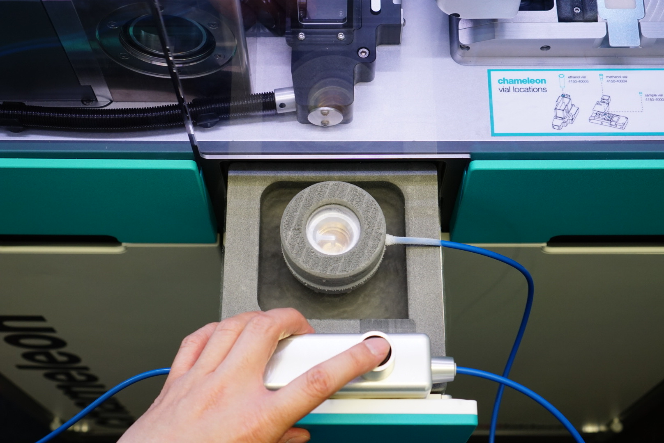
5. Fill Ethane to the Groove Inside the Ethane Cup
Press and hold the flow controller button to fill the cup with liquid ethane.
Once the ethane condensing set-up has been installed, the dispensing time should remain consistent if all valves are set appropriately and not changed.

Slide 11
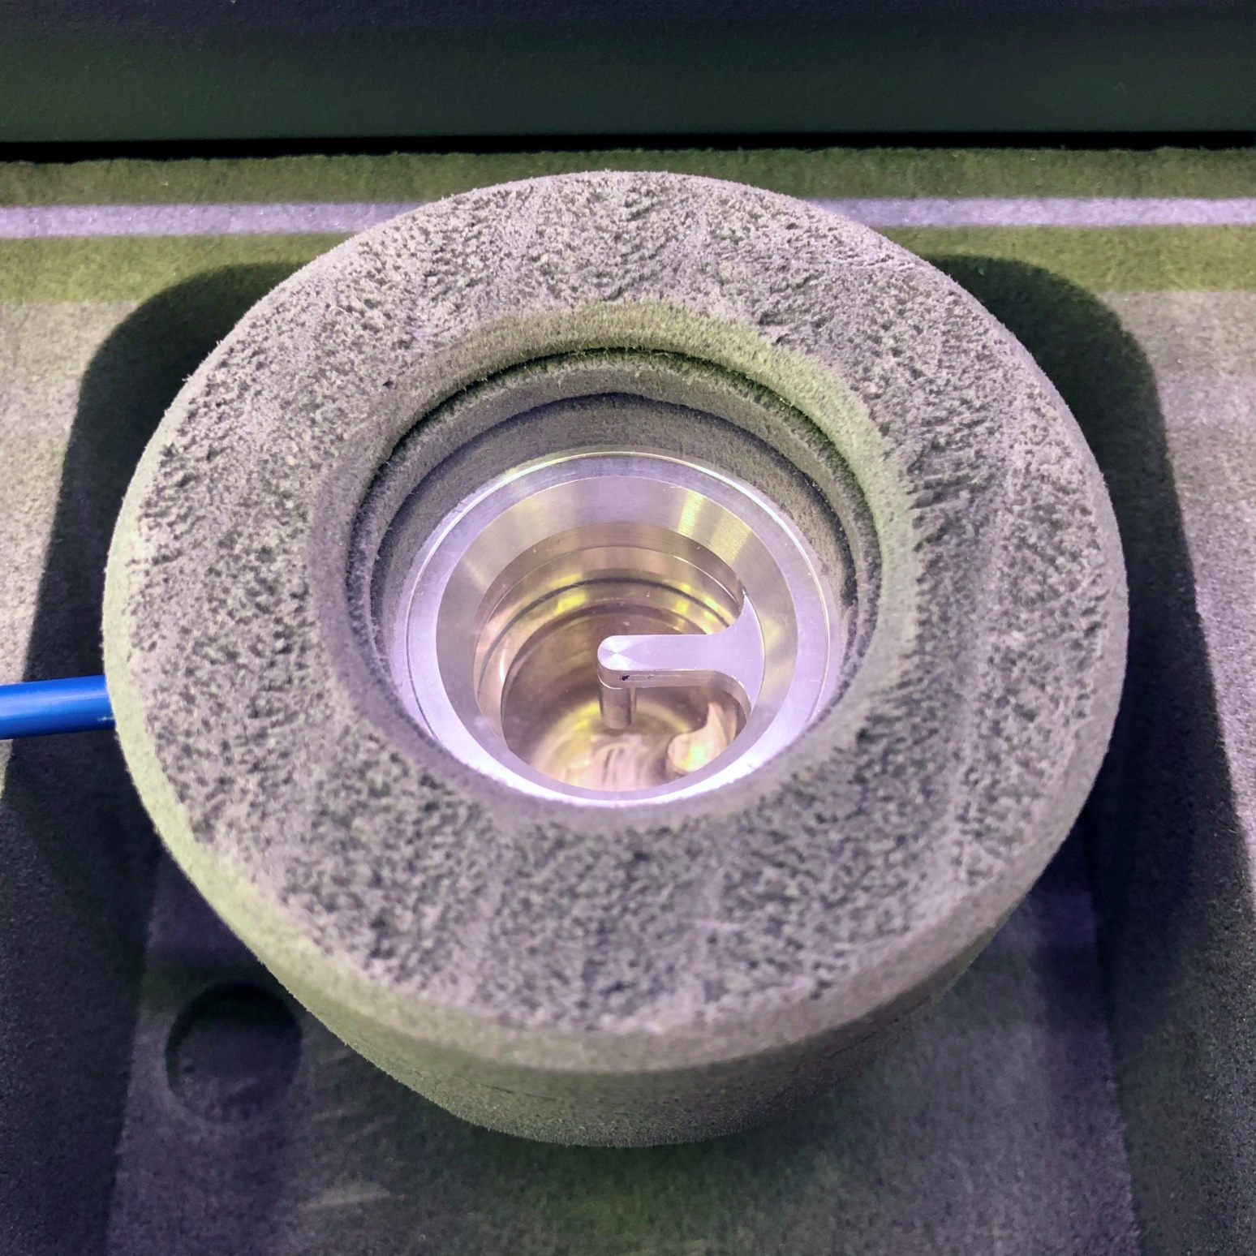
5. Fill Ethane to the Groove Inside the Ethane Cup
In all cases, the user should observe the liquid level through the window on top of the condenser to decide when to stop filling the ethane cup.
The ethane cup is fully filled when the gurgling sound changes. The level of the liquid ethane should just reach the bottom of the faucet.
Bottom of the faucet

Slide 12
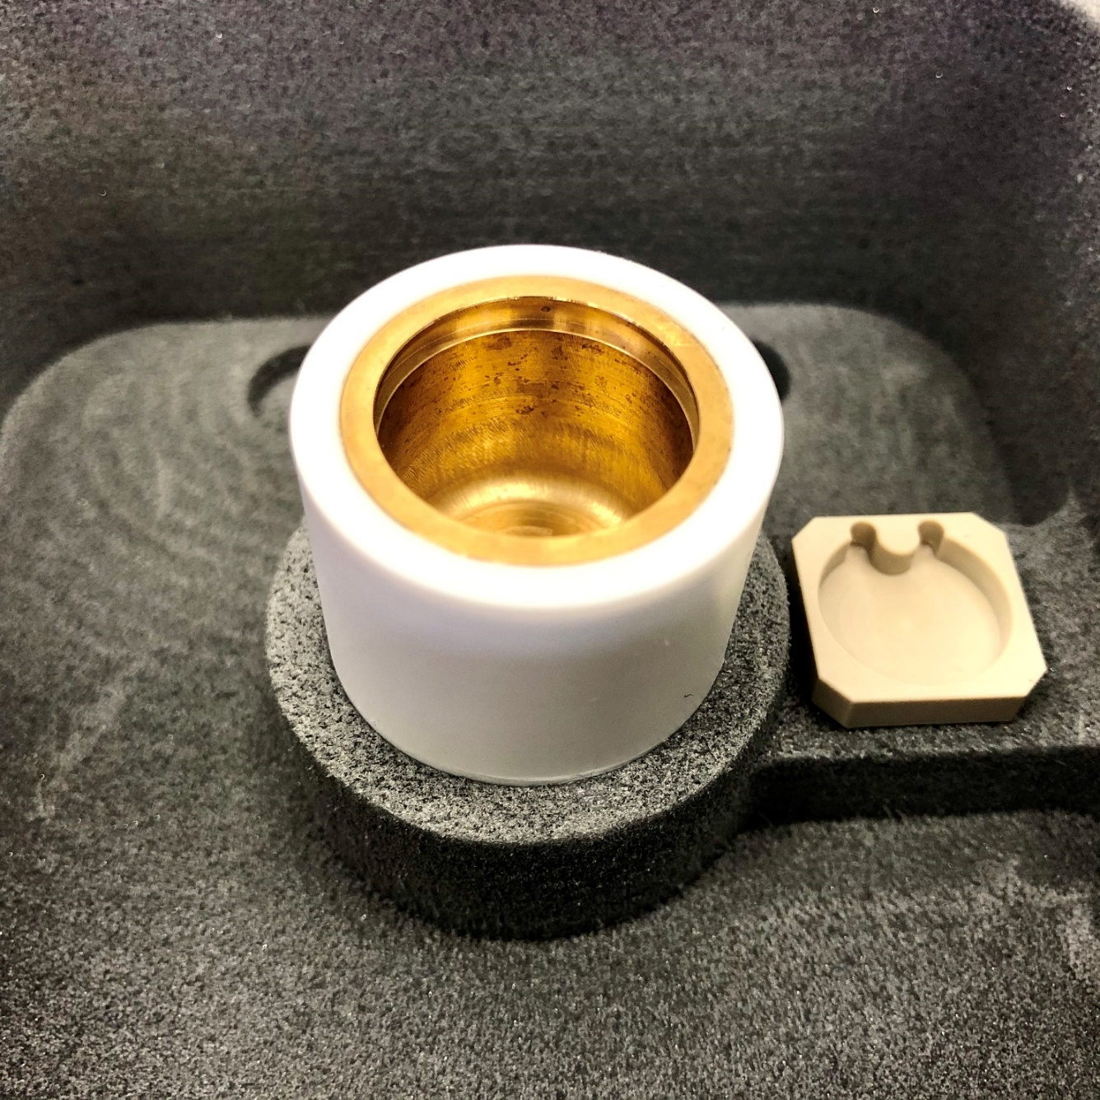
5. Fill Ethane to the Groove Inside the Ethane Cup
Groove inside the ethane cup
When ethane filling is complete, remove the ethane condensing head from the cryogen bowl.
Ethane should be filled at least to the groove inside the ethane cup.
If desired, the liquid ethane level can be checked by sliding the tips of a tweezer along the side of the ethane cup.

Slide 13
6. Top up liquid nitrogen
Top up the liquid nitrogen in the bowl, being careful not to get any into the ethane cup.
The height of the ethane cup is lower than the outside edge of the bowl. Be careful when refilling the liquid nitrogen.

Slide 14
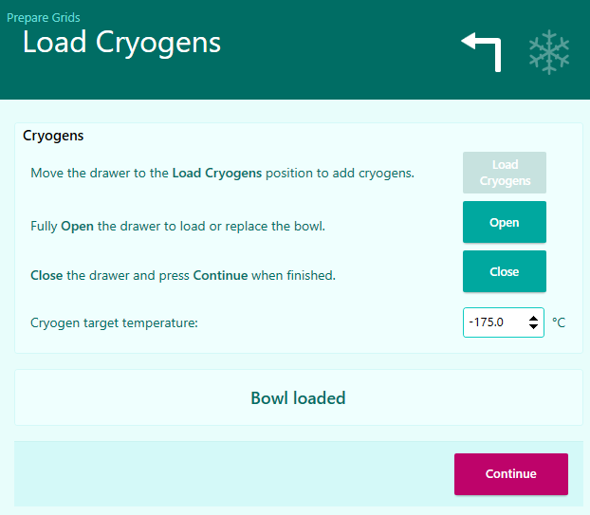
6. Top up liquid nitrogen
Press Close to continue. The cryogen drawer will now retract fully into the instrument.

Slide 15
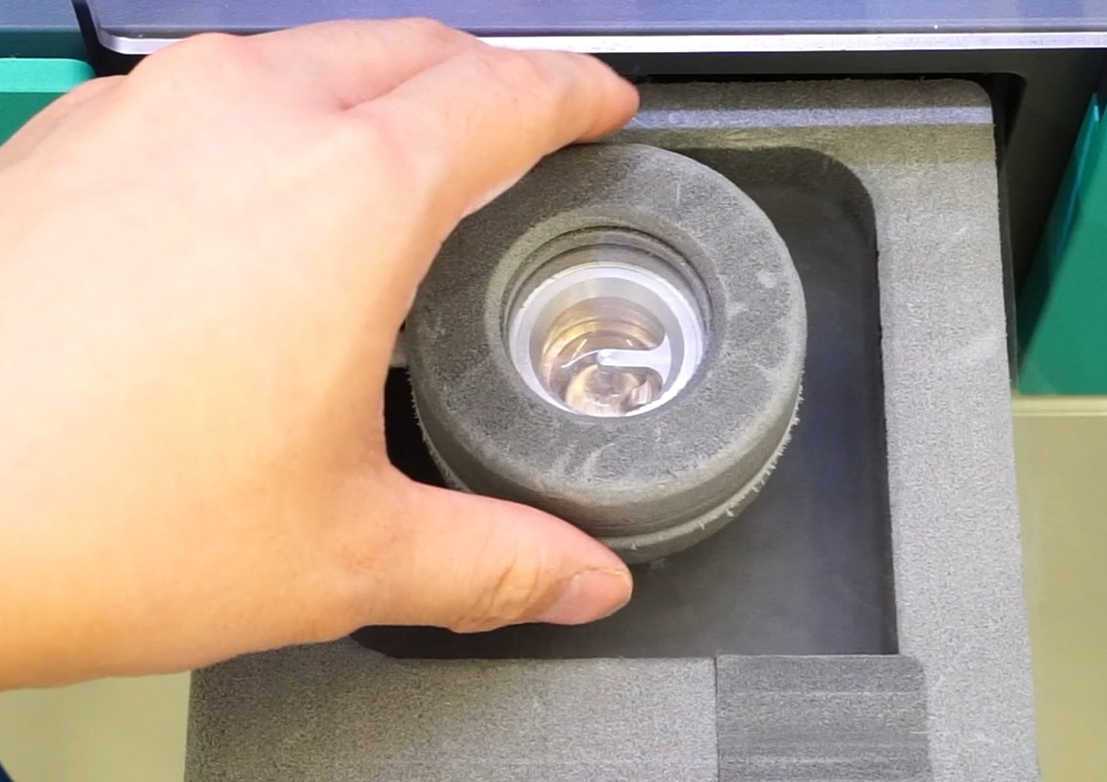
Overfilling liquid ethane
If the liquid ethane cup is overfilled, the ethane condensing head can freeze to the cryogen bowl.
DO NOT force the removal of the ethane condensing head as this may cause damage.

Slide 16
Overfilling liquid ethane
Press the Open button to open the cryogen drawer fully.
DO NOT PRESS CLOSE
Carefully pick up the cryogen bowl with ethane condensing head attached using the wings at the bottom of the bowl.
Once the cryogen bowl has been removed from the instrument, pour the cryogens out of the bowl and into a safe container. The ethane condensing head will need to be warmed up in order to be removed.

Slide 17
Overfilling liquid ethane
To continue the freezing session, fully warm up and dry both the cryogen bowl and ethane condensing head prior to attempting to fill again.
A blow drier can be used to speed this process after all liquid and gaseous ethane has been removed from the bowl and condensing head
DO NOT use a heat gun!

