Slide 1
Advanced Topics
chameleon V1.11

Slide 2
Concentration vs Dispense-to-Plunge Time & Specimen Size
Concentration is related to plunge time:
Concentration is related to specimen size:
Major improvements in air-water-interface issues (denaturation/preferred orientation) with shorter plunge time!
Ice thickness still plays a role – but can be identified during freezing rather than imaging
Shorter dispense-to-plunge time requires higher concentration
Protein Concentration
Longer
Shorter
Larger samples require higher concentration
Protein Concentration
Smaller
Larger

Slide 3
Shorter dispense-to-plunge time requires more concentrated sample
Plunging method | Dispense-to-Plunge time (ms) | Protein concentration (mg/mL) | Particles per micrograph (observed)
Vitrobot | n/a | 0.5 | 208
chameleon | 619 | 1 | 175
 | 390 | 1 | 269
 | 150 | 1 | 74
 | 54 | 4 | 71
 | 54 | 6 | 95
Moderate wicking samples require 2x – 3x concentration compared to blotting
Faster wicking samples require 6x – 10x concentration compared to blotting
Talya Levitz, Sheena Vasquez, Ed Brignole, Cathy Drennan at MIT Department of Biology

Slide 4
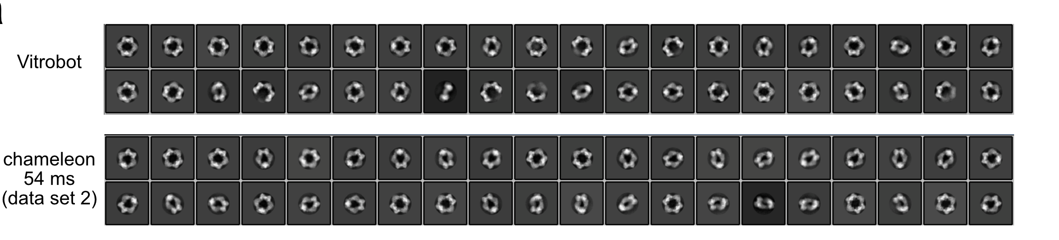
Shorter dispense-to-plunge time impact on denaturation
Talya Levitz, Sheena Vasquez, Ed Brignole, Cathy Drennan at MIT Department of Biology
Notes:
Short plunge time alleviates denaturation

Slide 5
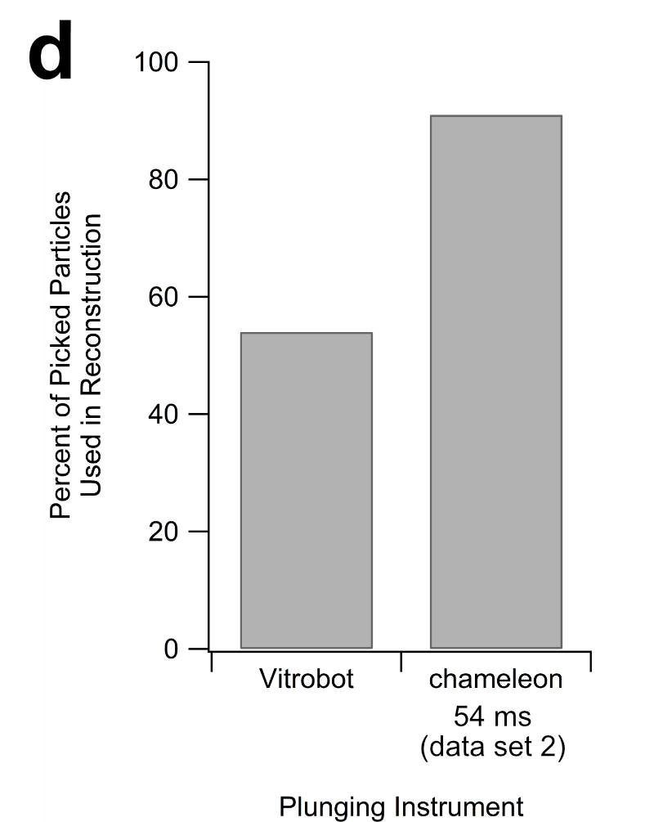
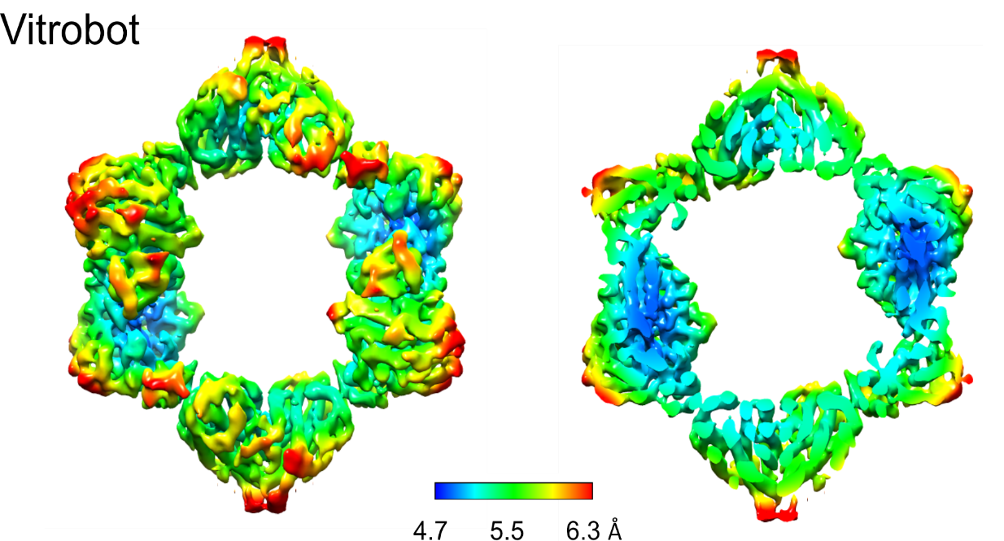
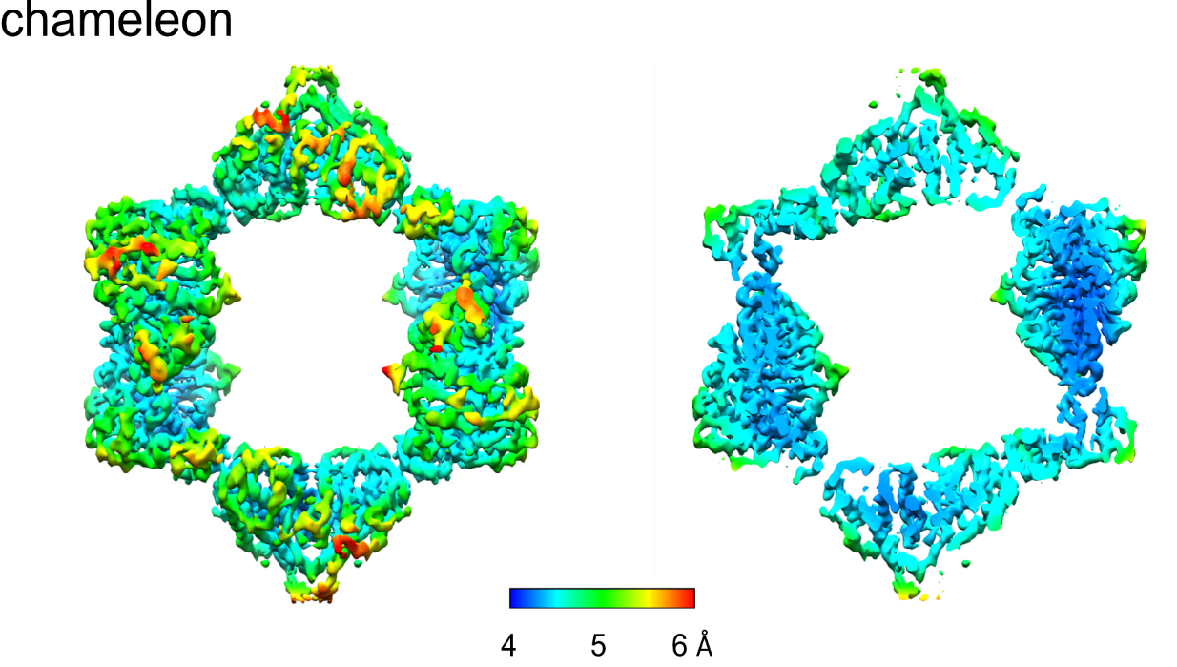
Shorter dispense-to-plunge time impact on denaturation
Higher percentage of picked particles from chameleon grid included in final reconstruction
Chameleon grids achieve higher resolution reconstruction
Talya Levitz, Sheena Vasquez, Ed Brignole, Cathy Drennan at MIT Department of Biology

Slide 6
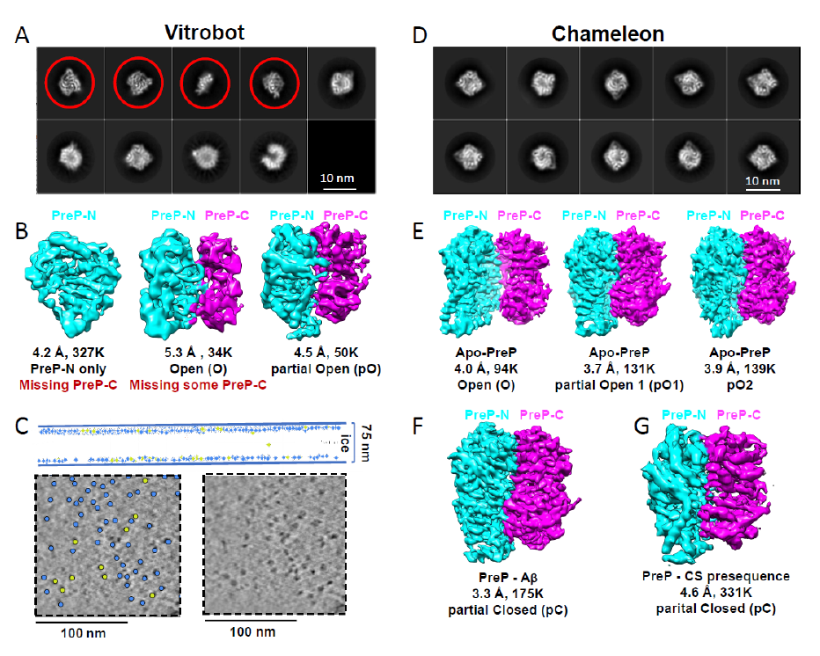
Shorter dispense-to-plunge time impact on denaturation
“Our cryoET analysis reveals that PreP, a 117 kDa, monomeric enzyme with homologous 55 kDa N- and C-domains preferentially absorbed to the air-water interface.
Such exposure likely caused preferential denaturation of the PreP-C domain.
Attempts in identifying better buffers using differential scanning fluorimetry (DSF), adding substrate, e.g., Abeta to lock PreP in the closed state, or altering the grid properties, e.g., grid with hydrophilized graphene, all failed to properly vitrify PreP (data not shown)27,44.”
12% of kept particles intact
Liang, W. et al. Structural basis for the mechanisms of human presequence protease conformational switch and substrate recognition. https://www.researchsquare.com/article/rs-63850/v1 (2020) doi:10.21203/rs.3.rs-63850/v1.

Slide 7
Shorter dispense-to-plunge time impact on denaturation
“We employed (the chameleon) to prepare grids using a 133 millisecond dwell time…”
“Following 2D and 3D classification, all classes were found to contain full-length PreP particles, and no denaturation was observed.”
“3D classification of PreP particles revealed three distinct open state structures of PreP.”
“Two substrate-bound PreP cryoEM structures were also determined.
…PreP in the presence of excess Aβ 1–40 yielding a partially closed (pC) state of PreP at 3.3 Å resolution.
…PreP in complex with a model presequence peptide from human citrate synthase (27 aa long, CS27), resulting in a pC state of PreP at 4.6 Å resolution.”
Liang, W. et al. Structural basis for the mechanisms of human presequence protease conformational switch and substrate recognition. https://www.researchsquare.com/article/rs-63850/v1 (2020) doi:10.21203/rs.3.rs-63850/v1.

Slide 8
Dispense-to-plunge time impact on Preferred Orientation
chameleon grids frozen at 54ms show improved angular distribution of views for HSP60
Klebl, D. P. et al. Need for Speed: Examining Protein Behavior during CryoEM Grid Preparation at Different Timescales. Structure 0, (2020).

Slide 9
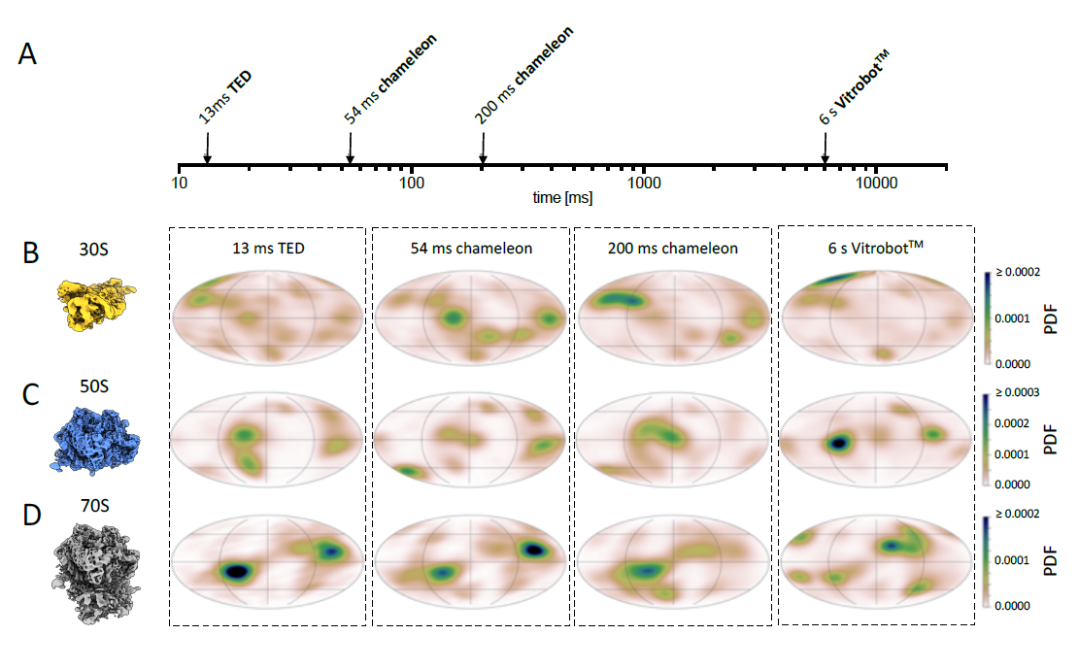
Faster is not always better
70s Ribosome plunged at 54ms shows stronger preferred orientation
Klebl, D. P. et al. Need for Speed: Examining Protein Behavior during CryoEM Grid Preparation at Different Timescales. Structure 0, (2020).

Slide 10
Factors to consider when freezing a new sample
Purpose of Freezing Session
  Are you aiming for control and consistency of thin film formation?
  Are you addressing air-water-interface issues (denaturation and/or preferred orientation)?
Sample Concentration
  Generally more concentrated sample is required compared to a blotting plunger
  Concentration and specimen size will dictate what dispense-to-plunge times are appropriate
  More concentrated samples will generally wick slower, so additional glow discharge will be needed to reach faster dispense to plunge times
Dispense to Plunge Time
  Particle density on micrographs drops with shorter dispense-to-plunge time
  Faster is not always better. Test a range of dispense-to-plunge times, e.g. 54ms, 100ms, 300ms, 500ms.
Ice Thickness
  Correlated to the degree of wicking on nanowire grids
  Modified by adjusting wicking speed and/or dispense-to-plunge time of the grid

Slide 11
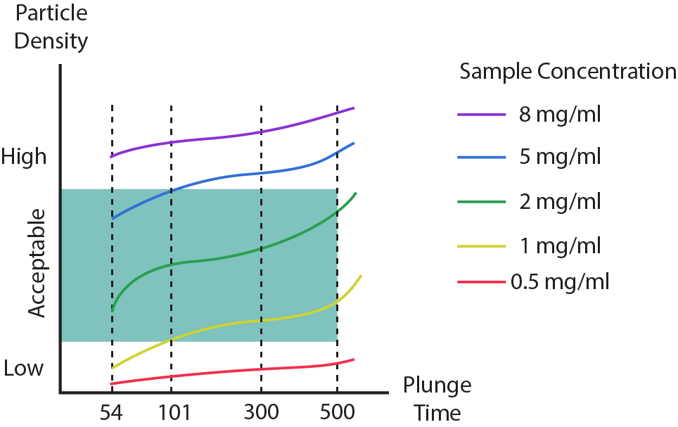
Approaching a New Sample - 1st Freezing Session
Goals:
Visualize particles
Determine the shortest dispense-to-plunge time possible for a given sample concentration without particle density dropping too low
Strategy:
Start with the highest possible sample concentration
  Have the best chance of visualizing particles across a range of dispense-to-plunge times
Freeze grids with a range of disepense-to-plunge times
  E.g. 54 / 101 / 300 / 500 ms
Accept grids with a wider range of ice thickness
  E.g. From good to overwicked

Slide 12
Approaching a New Sample - 2nd Freezing Session
Goals:
Freeze at optimized sample concentration / plunge time (determined during 1st freezing session)
Optimize for film thickness
Strategy:
Consider results from 1st freezing session
Choose plunge time appropriate for sample concentration
  E.g. for the 1mg/ml sample: 150 – 200ms
Stringently accept only those grids with appropriate plunge time and film thickness.

Slide 13
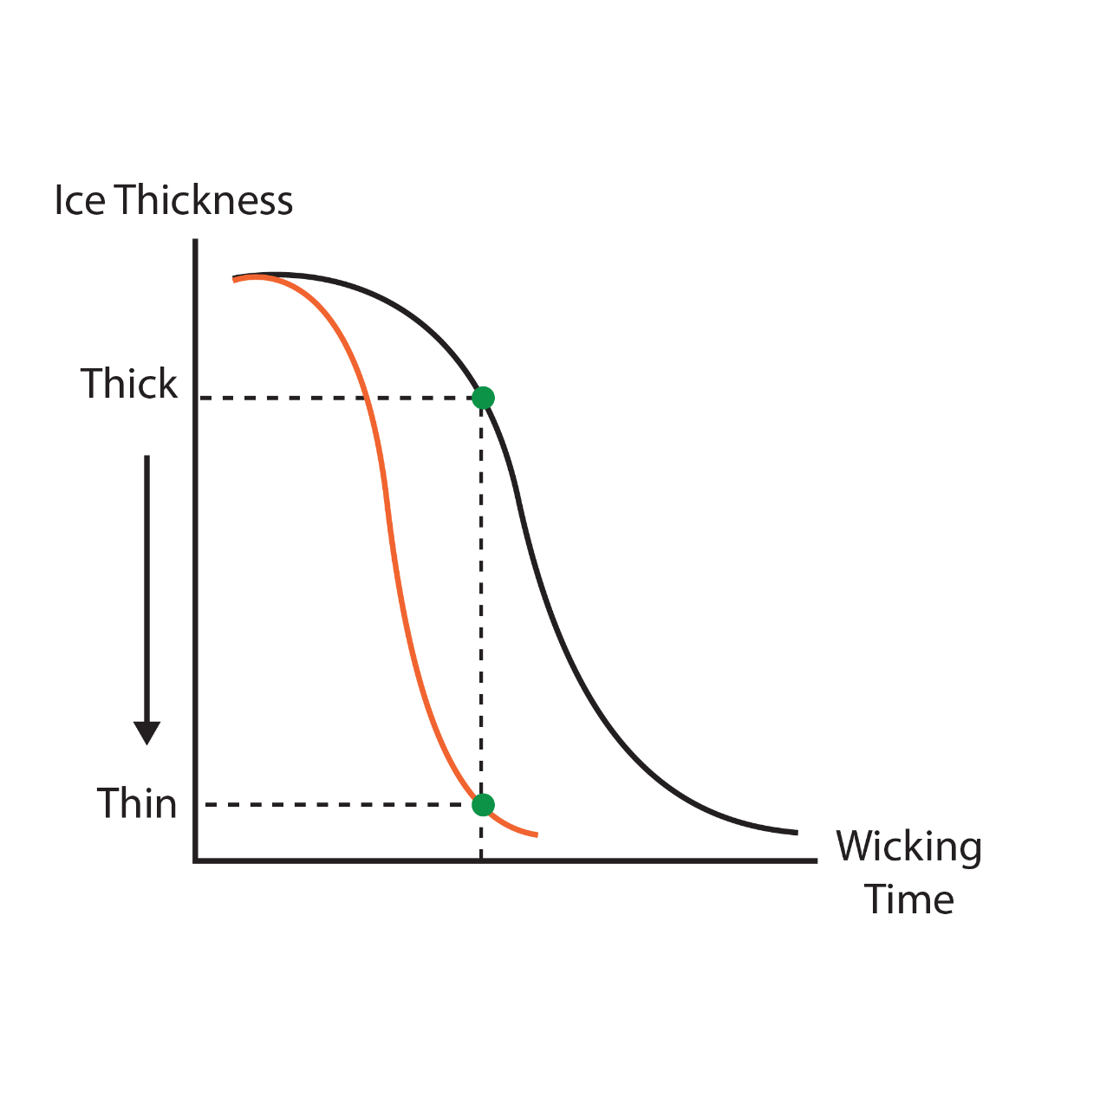
Effect of Sample Concentration and Glow Discharge on Wicking
1 mg/ml
50s GD
6 mg/ml
50s GD
6 mg/ml
100s GD
6 mg/ml
50s GD
101 ms
101 ms
Higher sample concentration slows wicking speed
Stronger glow discharge needed to achieve similar plunge time

Slide 14
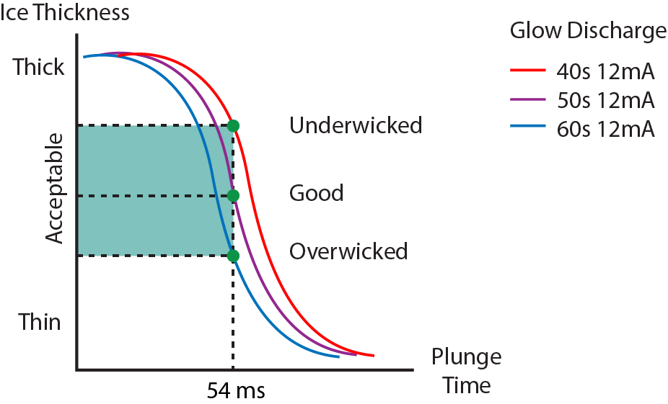
Targeting Plunge Time and Film Thickness
When targeting a dispense-to-plunge time (e.g. 101ms), the goal is to achieve an acceptable degree of wicking within a specified time
When dispense-to-plunge time and film thickness are fixed targets, the only variable that can be adjusted is glow discharge
101ms

Slide 15
Freezing Session Strategy
Use two-stripe mode to discover the approximate amount of glow discharge required for the targeted plunge time
Switch to one-stripe mode when wicking time is achieved in the wicking characterization step is near or at the targeted plunge time
Grid​ | Glow Discharge​ | Wicking Characterization​ | Plunge Offset​ | Plunge​ | Evaluation​
1 | 12mA 30s​ | 200ms​ | 3x​ | 600ms​ | Underwicked​
2 | 12mA 40s​ | 100ms​ | 2x​ | 200ms​ | Good
3​ | 12mA 40s​ | – | ​– | 101ms​ | Good
4​ | 12mA 40s​ | –​ | –​ | 54ms​ | Underwicked​
5 | 12mA 50s | – | – | 54ms | Good
6 | 12mA 60s | – | – | 54ms | Overwicked
101ms
Target plunge time: 54ms

Slide 16





Case Study #1 - 3mg/ml sample
Results from 1st Freezing Session
Plunge Time | 54ms | 101ms | 300ms | 500ms
Glow Discharge | 12mA 60s | 12mA 50s | 12mA 40s | 12mA 30s
Evaluations | Good | Good | Underwicked | Overwicked
Particle Density | Too Low | Acceptable, Low | Good | Good
2nd Freezing Session
  If sample does not have AWI issues, what plunge time should you target?
  If sample does have AWI issues, what plunge time should you target?

Slide 17
Case Study #2 – 4 mg/mL sample with AWI issues
Results from 1st Freezing Session
Plunge Time | 54ms | 101ms | 300ms | 500ms
Glow Discharge | 12mA 60s | 12mA 50s | 12mA 40s | 12mA 30s
Evaluations | Underwicked | Good | Very Good | Overwicked
Particle Density | Acceptable, Low | Acceptable, Low | Good | Good
2nd Freezing Session
  What plunge time would you aim for? Why?
  What glow discharge time would you use for the second freezing session? Why?
Notes:
Maybe 65s glow discharge?

Slide 18
Key Points Summary
Optimal sample concentration is related to both dispense-to-plunge time and specimen size
  Faster plunge times generally require higher sample concentrations
For many samples, faster plunge times can improve air-water-interface issues. But for a small number of samples, the reverse is true.
Approaching a new sample should be done in two stages:
  Using a relatively high concentration, prepare multiple grids with various plunge times and film thicknesses. Screen to visualize particles.
  Choose an appropriate concentration, target plunge time, and film thickness to prepare grids. Be stringent in grid acceptance.
Glow discharge can be used to control wicking:
  When increasing sample concentration, more or stronger glow discharge will be needed to get to the same plunge times.
  When shifting to faster plunge times (holding sample concentration constant), more or stronger glow discharge will be needed.

Slide 19
Quiz
When sample concentration increases and the same amount of glow discharge is applied to a grid, plunge time is expected to:
  Increase
  Decrease
With faster plunge times, particle density on micrographs is expected to
  Increase
  Decrease
What parameters can be changed to adjust ice thickness when holding plunge time constant during freezing?
  Dispenser amplitude
  Plunge offset
  Glow discharge time
  Glow discharge current
Which of the following factors should be taken into consideration when choosing a particular plunge time?
  Sample concentration
  Sample size
  Sample susceptibility to denaturation
  Sample susceptibility to preferred orientation
  All of the above

